Slide 1
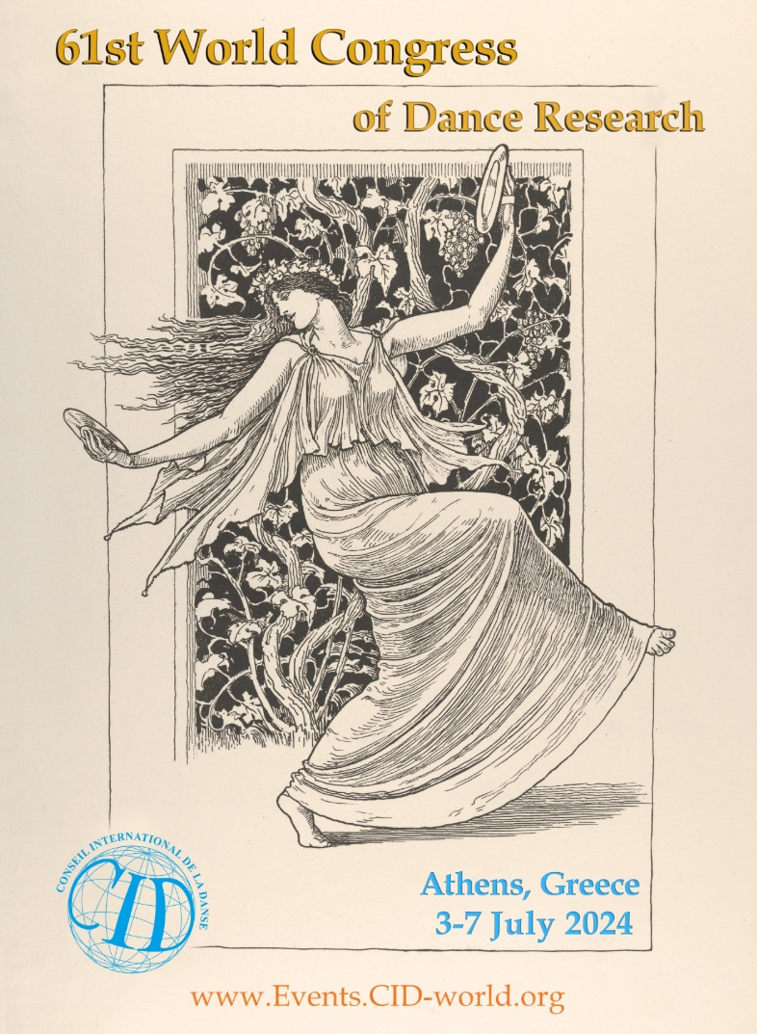
61st WORLD CONGRESS OF DANCE RESEARCH
ATHENS/GREECE 2024

Slide 2
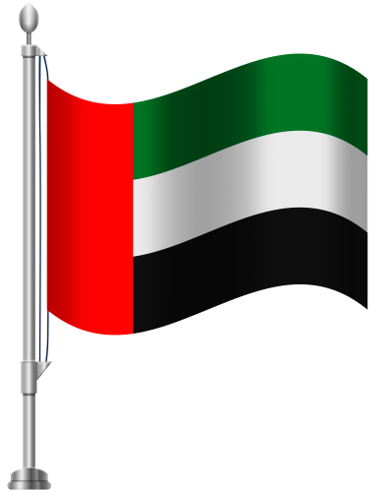
LECTURE
THE RESPECTFUL TRADITIONAL DANCES OF UNITED ARAB EMIRATES (UAE)
By the Research of Maria Athanasiadou/Ellas
Dance Researcher/Teacher/Choreographer

Slide 3
Sheikh Zayed Bin Sultan AL Nahyan December 2nd 1971/birth of UAE He was a wise man with a vision who changed the history, not only for his country, but also for every human being all over the World. The values and respect he transmitted and was spread, is reflected throughout the Emirates region, but also to those people who understand the greatness of the values that all people should have

Slide 4
7 EMIRATES UNITED: Abu Dhabi, Dubai, Sharjah, Ras Al Khaymah, Ajman, Umm Al Qaywayn and Fujirah

Slide 5
THE 7 LEADERS OF THE 7 UNITED EMIRATES

Slide 6
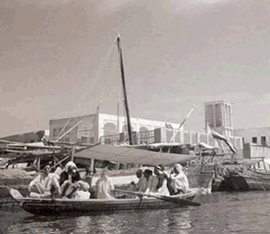
Historical Context
Historical Events:
“The UAE has been called “Al Ghabraa” and then the Coast of Oman as it is connected to Oman. It has been inhabited by several tribes such as Bani Yas, a tribe that is said to belong to Al Yas Bin Amir and to be composed of a tribal alliance; a policy which was adopted by Arabs to face hazards. Descendants of Bani Yas include the families of Al Nahyan, Al Maktoum – Rulers of Abu Dhabi and Dubai, and Al Qawassim, Rulers of Ras Al Khaimah and Sharjah.”

Slide 7
UAE dances are deeply rooted int the Bedouins culture, reflecting the history and the traditions of the Arabian Peninsula. These dances often tell stories from daily life, from battles and of course from Celebrations

Slide 8
Daily Life example 1 10th May 1949, “travelling south from Magta’a. The 4 of the 7 camels were ridden by ladies and were being led by Bedu.

Slide 9
Daily Life Example 2 Water had to be carried in goat skins from the wells to the huts and to the newly planted palms.

Slide 10
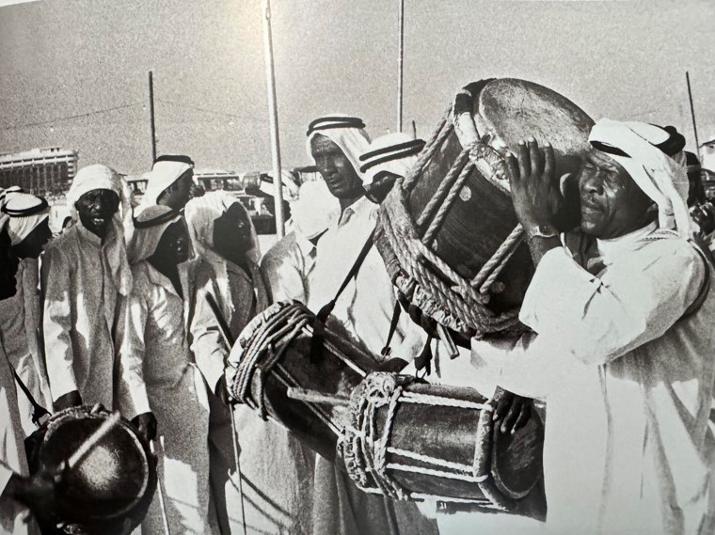
Music in UAE dances
Music in UAE dances typically features traditional instruments like drums, tambourines, and sometimes string instruments. The rhythms are often complex and deeply connected to the dance movements. The rhythmic beat of drums are an integral and memorable part of folk dancing.

Slide 11
Music in UAE dances instruments of African origin were often played by entertainers at celebrations

Slide 12
Music in UAE Dances

Slide 13
Symbolisand Expression Dances in the UAE can be symbolic of tribal identity, social status, and communal unity. It's a way to express joy, hospitality, and solidarity among community members

Slide 14
Symbolism and Expression Dance can be a Form of Expression and carry symbolic or Ceremonial connections

Slide 15
Rhythm and Steps
UAE dances are known for their rhythmic complexity and precise, coordinated movements. These dances often involve clapping, drumming, and synchronized group movements.
Basic UAE dances:
Ayyala: A traditional group dance, often performed by men, that symbolizes unity and strength. It involves synchronized movements, rhythmic drumming, and poetic chanting.
Yowla: A dance that includes elements of martial arts and is performed with a stick or a rifle, usually by men. It's a display of agility, coordination, and cultural pride. Yowla dance symbolizes unity, pride, and joy. It reflects the cultural heritage of the UAE and is a way to express happiness and excitement during weddings and other significant celebrations.

Slide 16
Rhythm and Steps
Liwa: A dance associated with the coastal areas of the UAE, often performed at weddings and social gatherings. It has African influences and is accompanied by upbeat drumming.
Al Razfa: Al Razfa is another traditional dance that is common in the UAE. It is characterized by the use of rifles or sticks held by the performers, who dance in a circle while chanting and swaying to traditional music. The dance is often performed at cultural events and national celebrations.
Al Harbiya: Al Harbiya is a Bedouin dance that reflects the nomadic heritage of the UAE. It involves men and women dancing in a line or a circle, with rhythmic movements and clapping. This dance is often accompanied by traditional music and poetry.

Slide 17
Rhythm and Steps
Al Khaleeji: Al Khaleeji, also known as Khaleeji dance, is a lively and energetic dance style that is popular in the Gulf region, including the UAE. It is often performed at social gatherings and weddings. Khaleeji dance involves intricate footwork, hand movements, and expressive body language, and it is typically performed by women.
Na’ ashat: In this dance, women usually stand in lines or groups, performing rhythmic clapping and moving in unison. The dance may include the use of handkerchiefs or scarves that are swayed to the rhythm. The movements are more restrained compared to the male dances but are deeply expressive.
Cultural Significance: Na'ashat is often performed at weddings and other celebrations, symbolizing unity and shared joy among the women of the community. It's a dance that celebrates the collective spirit and support among women.

Slide 18
Rhythm and Steps
Al Ayyala (Women's Version):
Description: While Al Ayyala is predominantly a male dance, there are versions where women participate, especially in mixed-gender settings. Women's participation often involves less aggressive movements compared to men, focusing on graceful postures, clapping, and chanting.
Cultural Significance: When performed by women, Al Ayyala helps to underline the role of women in cultural heritage, showcasing their importance in perpetuating traditional customs and social cohesion.
These dances are not just artistic expressions but are also integral to the social fabric of the Emirati communities, serving as a vehicle for cultural transmission and community bonding. They offer insight into the values, aesthetics, and societal roles within the UAE, helping to preserve these elements for future generations.

Slide 19
MEN TRADITIONAL COSTHUME 1
Men's traditional attire for performing dances in the UAE is both distinctive and symbolic, reflecting the cultural heritage and environmental conditions of the region. Here are the key components of the traditional outfit worn by men during performances of UAE dances:
1. Kandura (Dishdasha)
Design Details: The kandura is usually made from lightweight cotton or linen, ideal for the UAE's hot climate. It typically features a long tassel called a "tarboosh" that hangs from the neckline. The length and style of the kandura can vary slightly depending on the region within the UAE.
Cultural Significance: The simplicity and elegance of the kandura represent modesty and equality among men in social settings.
2. Ghutra and Agal
Design Details: The ghutra is typically made from a square cloth, folded into a triangle and placed over the head. Depending on the occasion, it can be plain or patterned. The agal, traditionally a thick black cord, is doubled and looped over the ghutra to hold it in place.
Cultural Significance: Historically, the ghutra protected the wearer from the harsh desert sun and sand, while the agal was reportedly used to tether camels in the desert. In dance, these items are integral for adding an authentic Emirati visual element to the performance.
3. Na-aal (Sandals) Design Details: These are traditionally made from leather with minimalistic designs. They are designed to be sturdy yet comfortable, allowing for flexibility and ease of movement during dance.
Cultural Significance: The practical design reflects the adaptability and resilience of the Bedouin lifestyle, facilitating movement across different terrains.

Slide 20
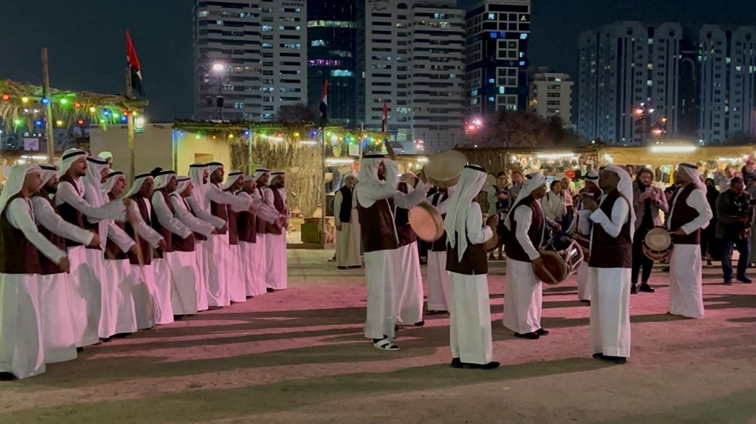

Slide 21
MEN TRADITIONAL COSTHUME 2
4. Bisht
Design Details: A bisht is often black, brown, or cream and may feature intricate gold or silver embroidery along the edges and sometimes on the back. The fabric used is usually heavier than that of the kandura, providing a dramatic, flowing appearance as the dancer moves.
Cultural Significance: The bisht is a symbol of prestige and is often worn by dignitaries and on special occasions. In dance, it emphasizes the importance of the event and honors traditional values.
5. Waistband (Belt)
Design Details: The belt can be a simple cord tied around the waist or a more ornate belt made of woven fabrics or leather. It may also include metal work or embroidery to match the bisht.
Cultural Significance: Besides being functional, the belt often serves as a decorative element that complements the overall attire and can be used to display daggers or other ornamental accessories that signify status and heritage.
These traditional garments and accessories are not only functional but also deeply imbued with cultural meaning. They connect the performers with their heritage, serving as a visual expression of their identity and history during the dance performances. This attire enhances the storytelling aspect of traditional dances, making them a rich, cultural spectacle.

Slide 22
KNIFE

Slide 23
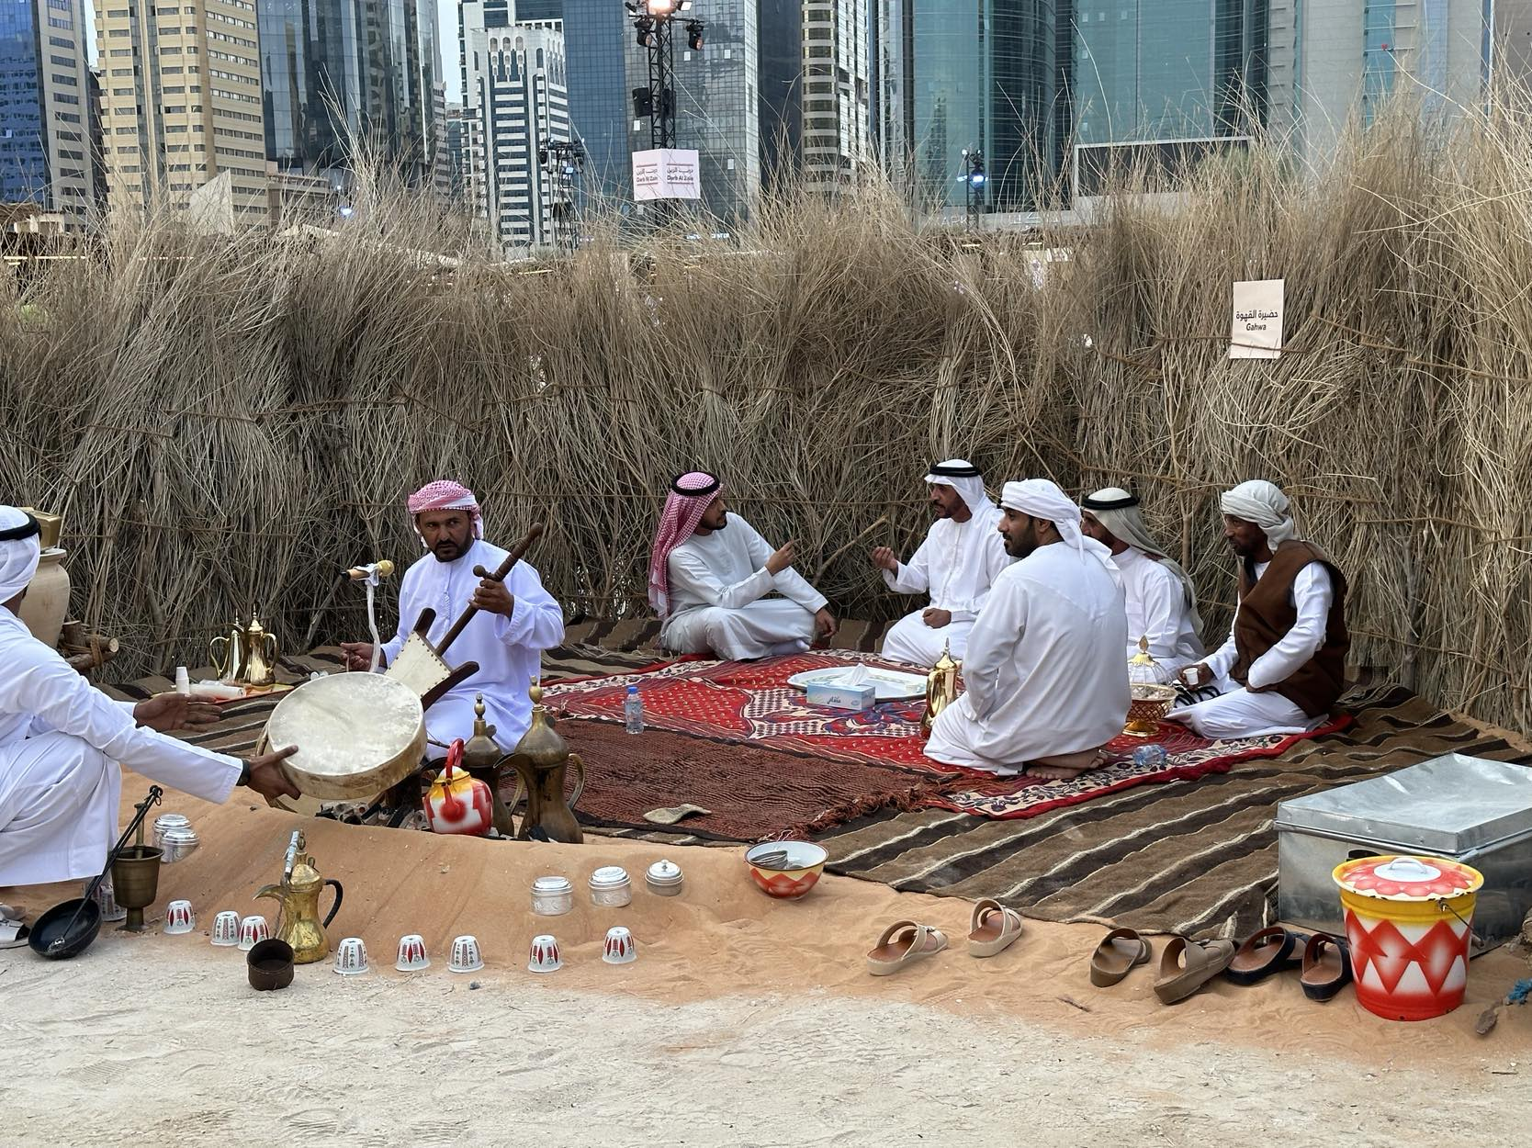

Slide 24
WOMEN TRADITIONAL C0STHUME 1
In traditional Emirati dance performances, women's attire is both beautiful and culturally significant, designed to enhance the aesthetics of their movements while adhering to the values of modesty and elegance. Here are the key components of the traditional outfit worn by Emirati women during dance performances:
Abaya:
This is a long, flowing black robe that is worn over clothing. It is often made of light, flowing fabrics like silk or chiffon to allow for graceful movement during dances. The abaya may be simple for everyday wear but can be elaborately embroidered with gold or silver threads, sequins, or crystals for performances and special occasions.
Sheila (Headscarf):
The sheila is a long scarf that covers the hair. For dance performances, it can be styled in various ways to secure the hair and often complements the color and embellishment of the abaya. It may also be adorned with embroidery or beading to match the abaya, adding an element of coordination and elegance.
Gishwa:
In more traditional settings or specific types of dance, a gishwa, a thin veil that covers the face, may be worn. It allows the wearer to see out while preventing others from seeing in, thus adhering to traditional values of modesty.

Slide 25
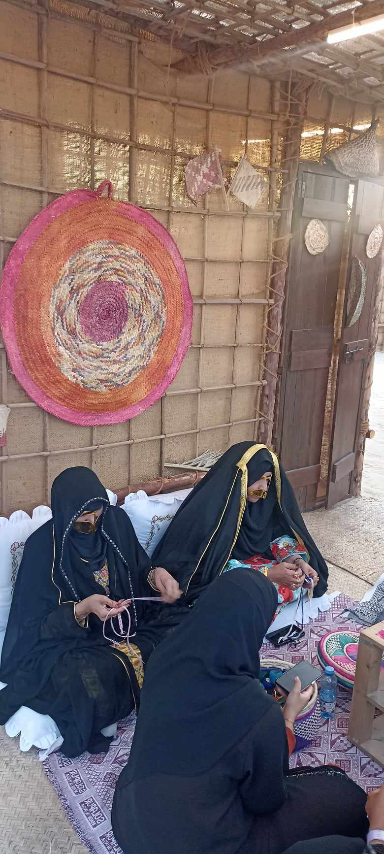
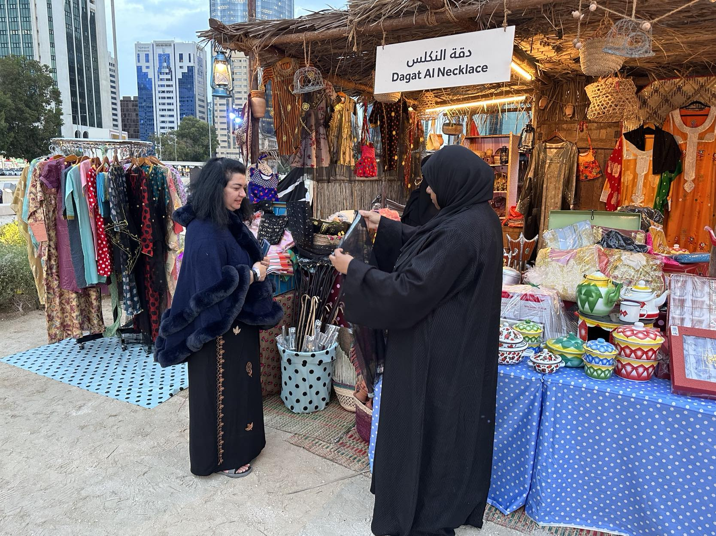
WOMEN MAKING BASKETS

Slide 26
WOMEN TRADITIONAL C0STHUME 2
Thobe:
For dances that are more specific to cultural representations, women might wear a thobe instead of an abaya. A thobe is a colorful and richly decorated dress that can have various designs, vibrant fabrics, and detailed embroidery, showcasing traditional craftsmanship.
Jewelry:
Traditional jewelry is an integral part of the dance costume, often made from gold or silver and sometimes adorned with pearls or colorful stones. Common pieces include necklaces, earrings, bracelets, and rings. Jewelry can also include hair ornaments and brooches that attach to the headscarf or thobe.
Footwear:
Typically, women wear simple flats or go barefoot, depending on the dance form and the venue. The choice of going barefoot is often made to facilitate ease of movement and to maintain a connection with the ground during traditional dances.
This attire is carefully chosen to not only respect the cultural traditions and modesty standards of the UAE but also to enhance the visual impact of the dance performances, helping to convey the beauty and grace of Emirati culture.

Slide 27
WOMEN TRADITIONAL COSTHUME 3
Cultural Significance: The choice of footwear, often minimal or absent, underlines a practical approach suited to dance and movement, connecting the dancer with the physical performance space.
This detailed ensemble not only reflects the cultural values of modesty and community but also showcases the artistic and aesthetic sensibilities of Emirati women. In dance, every aspect of the attire works together to enhance the visual experience and cultural storytelling.

Slide 29
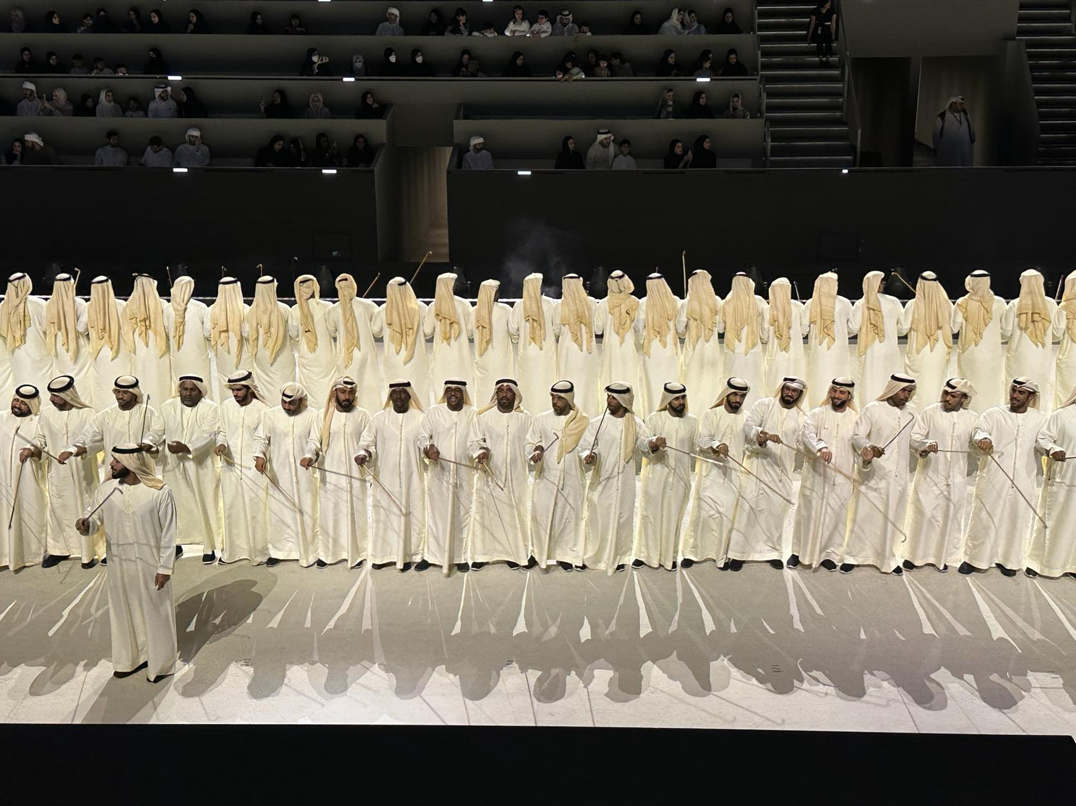

Slide 30
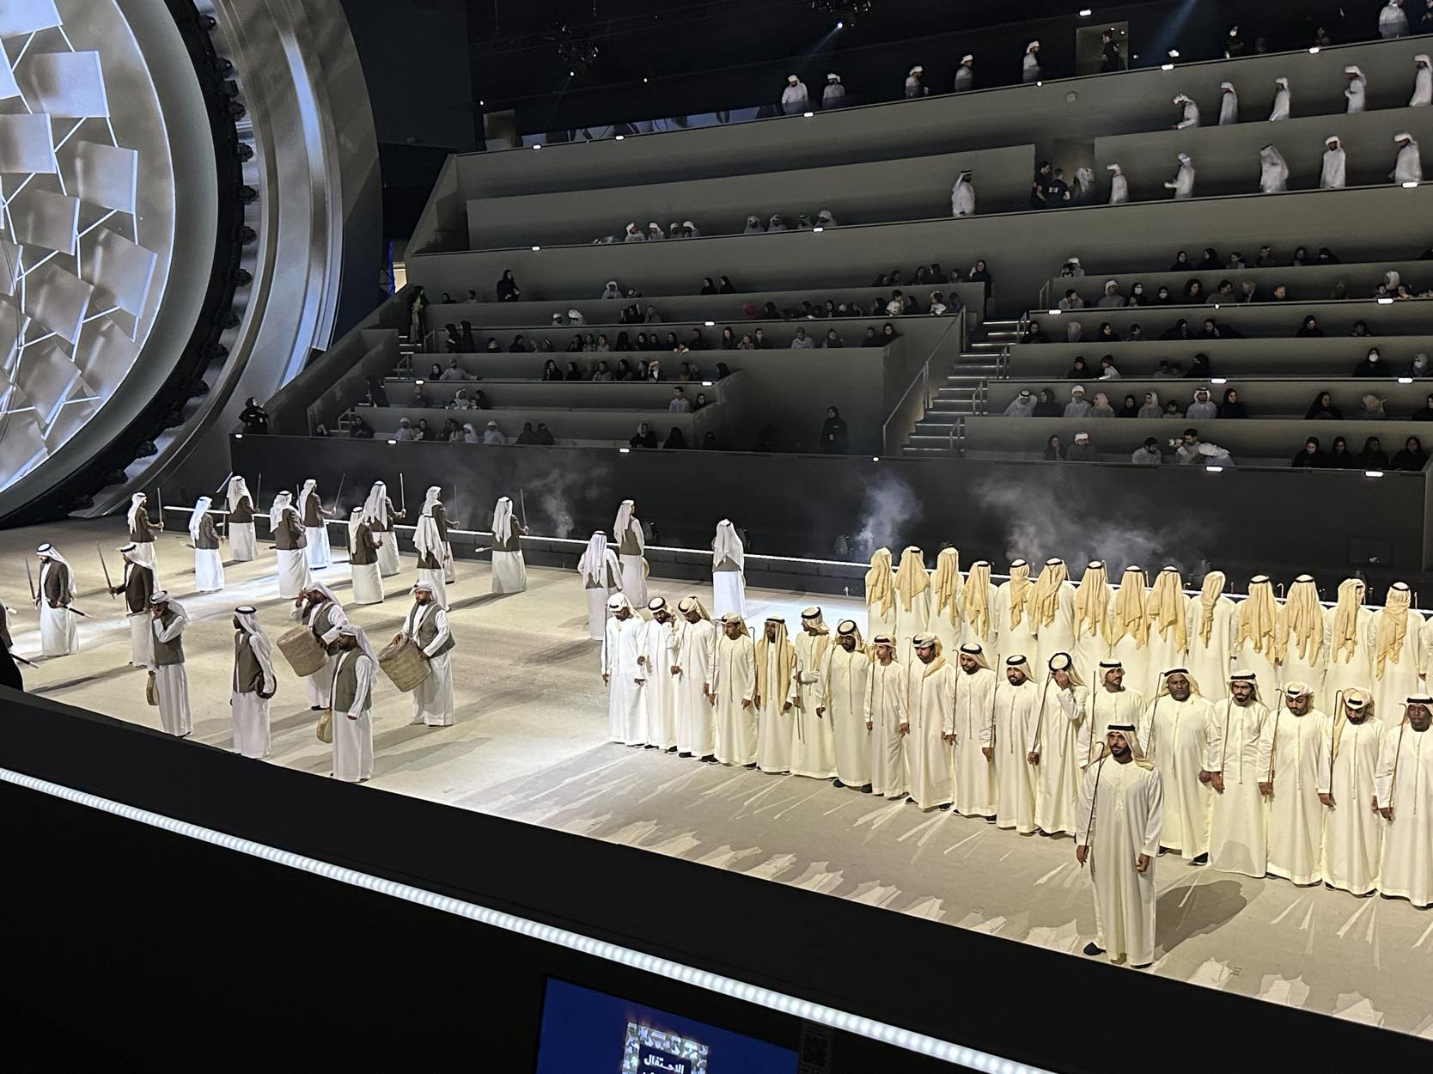

Slide 33
Thank you !!!
Hoping to meet again in next year’ s World Congress of Dance Research
Maria Athanasiadou /Ellas

