Slide 1
Supported using public funding by Slovak Arts Council
75th anniversary of the Academy of Performing Arts in Bratislava 1949 -2024
Projects of the Research Centre in Cooperation with the Dance Department
of the Academy of Performing Arts in Bratislava since 2011
Mgr. art. Ivica Liszkayová, PhD.

Slide 2
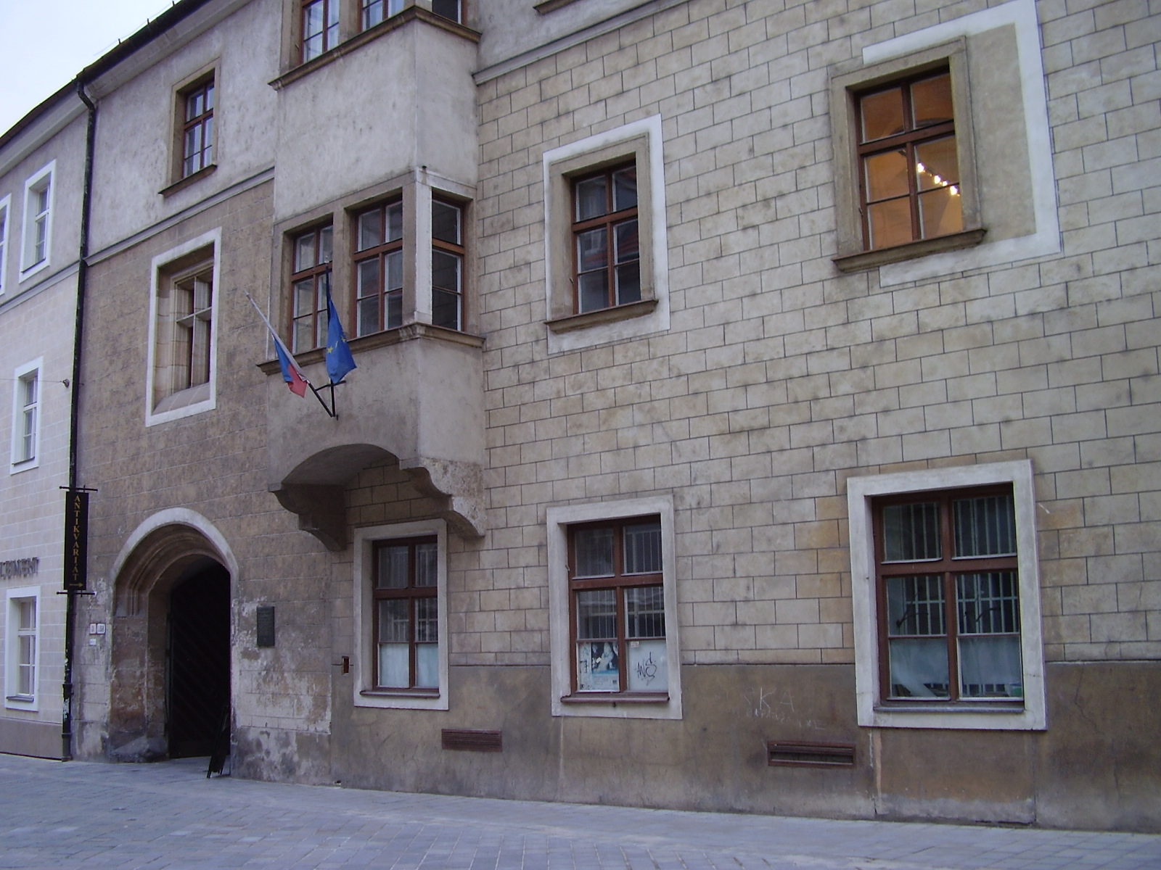
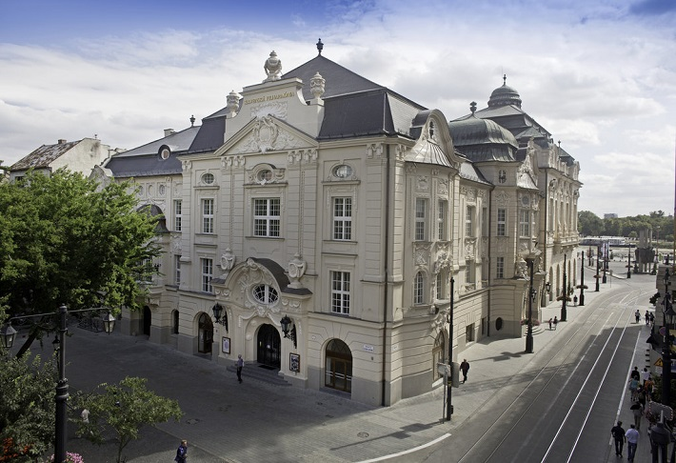
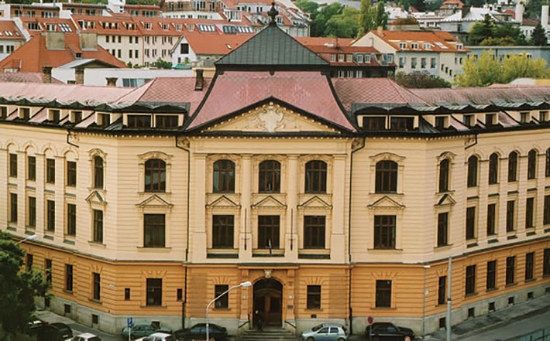
Slovakia, Bratislava, Academy of Performing Arts, Music and Dance Faculty
1949 - Establishment of the Academy of Performing Arts

Slide 3
Why was I interested in starting research in dance art?
1949 - Establishment of the Academy of Performing Arts
1951 - Establishment of the Dance Department
1955 - the first graduates of the Dance Department
professionals in dance art in Slovakia
1981 - 1985 – my studies in dance pedagogy
1986 – 1987 worked in the Research and Recording Centre
of The Academy of Performing Arts Bratislava, Slovakia (VŠMU)
1999 – 2016 taught at the Dance Conservatory of E. Jaczová in Bratislava
2008 graduated in PhD. at Constantine the Philosopher University in Nitra
2000 - Establishment of a Research center of Music and Dance Fakulty only for music research
2011 Research Centre The Academy of Performing Arts - My beginning of work for Dance Research

Slide 4
In 2011 I had an intention to:
start theoretical research in the field of dance in Slovakia (past, present, new trends in the world)
develop lifelong education system for former Dance Department graduates (theoretical lectures, practical seminars, written outputs)
organize congress of dance art
make dance art visible

Slide 5
The projects that I started to develop are currently repeated periodically:
Theoretical Analyses in Dance Art (2011 – 2024)
Dance Congress – Tanec.SK (2014 – 2024)
University Dance Art Presentations Abroad (2016, 2018)
KEGA - Cultural and educational grant agency, (2017 – 2024)
Ministry of Education, Science, Research and Sports
of the Slovak Republic

Slide 6
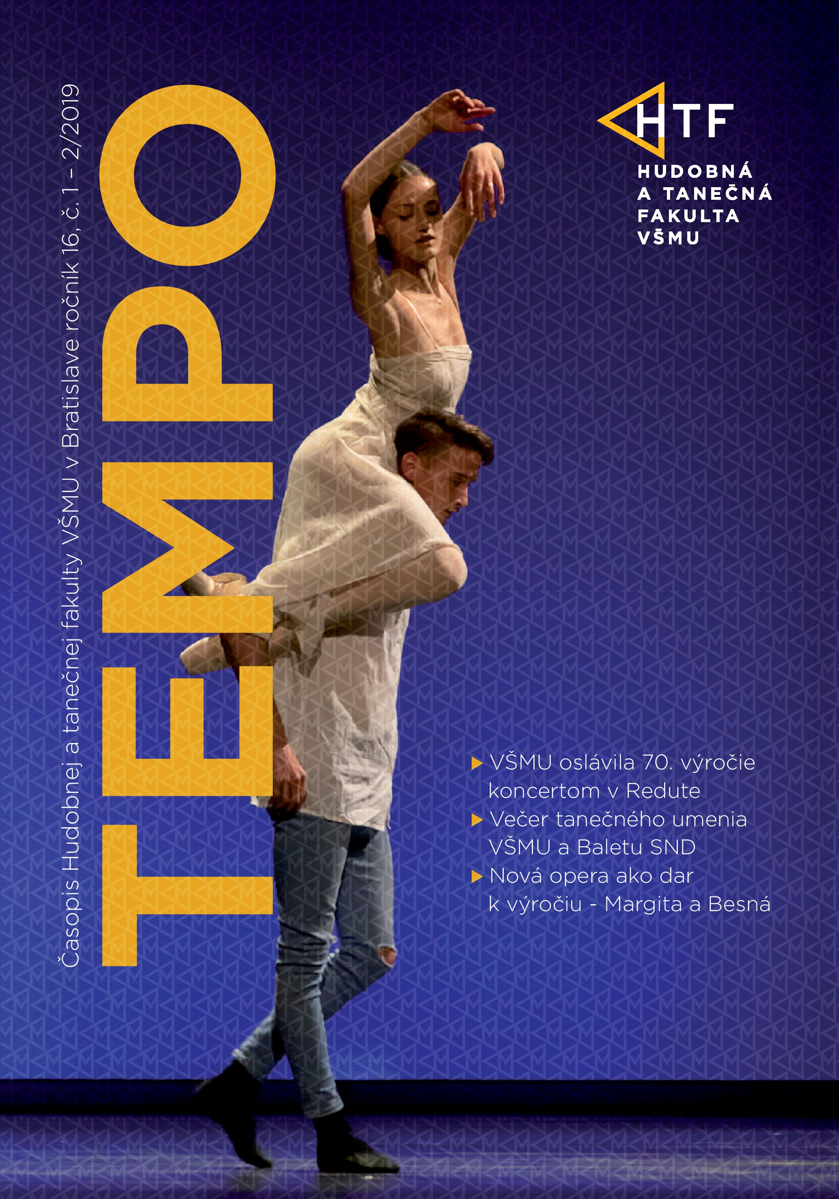
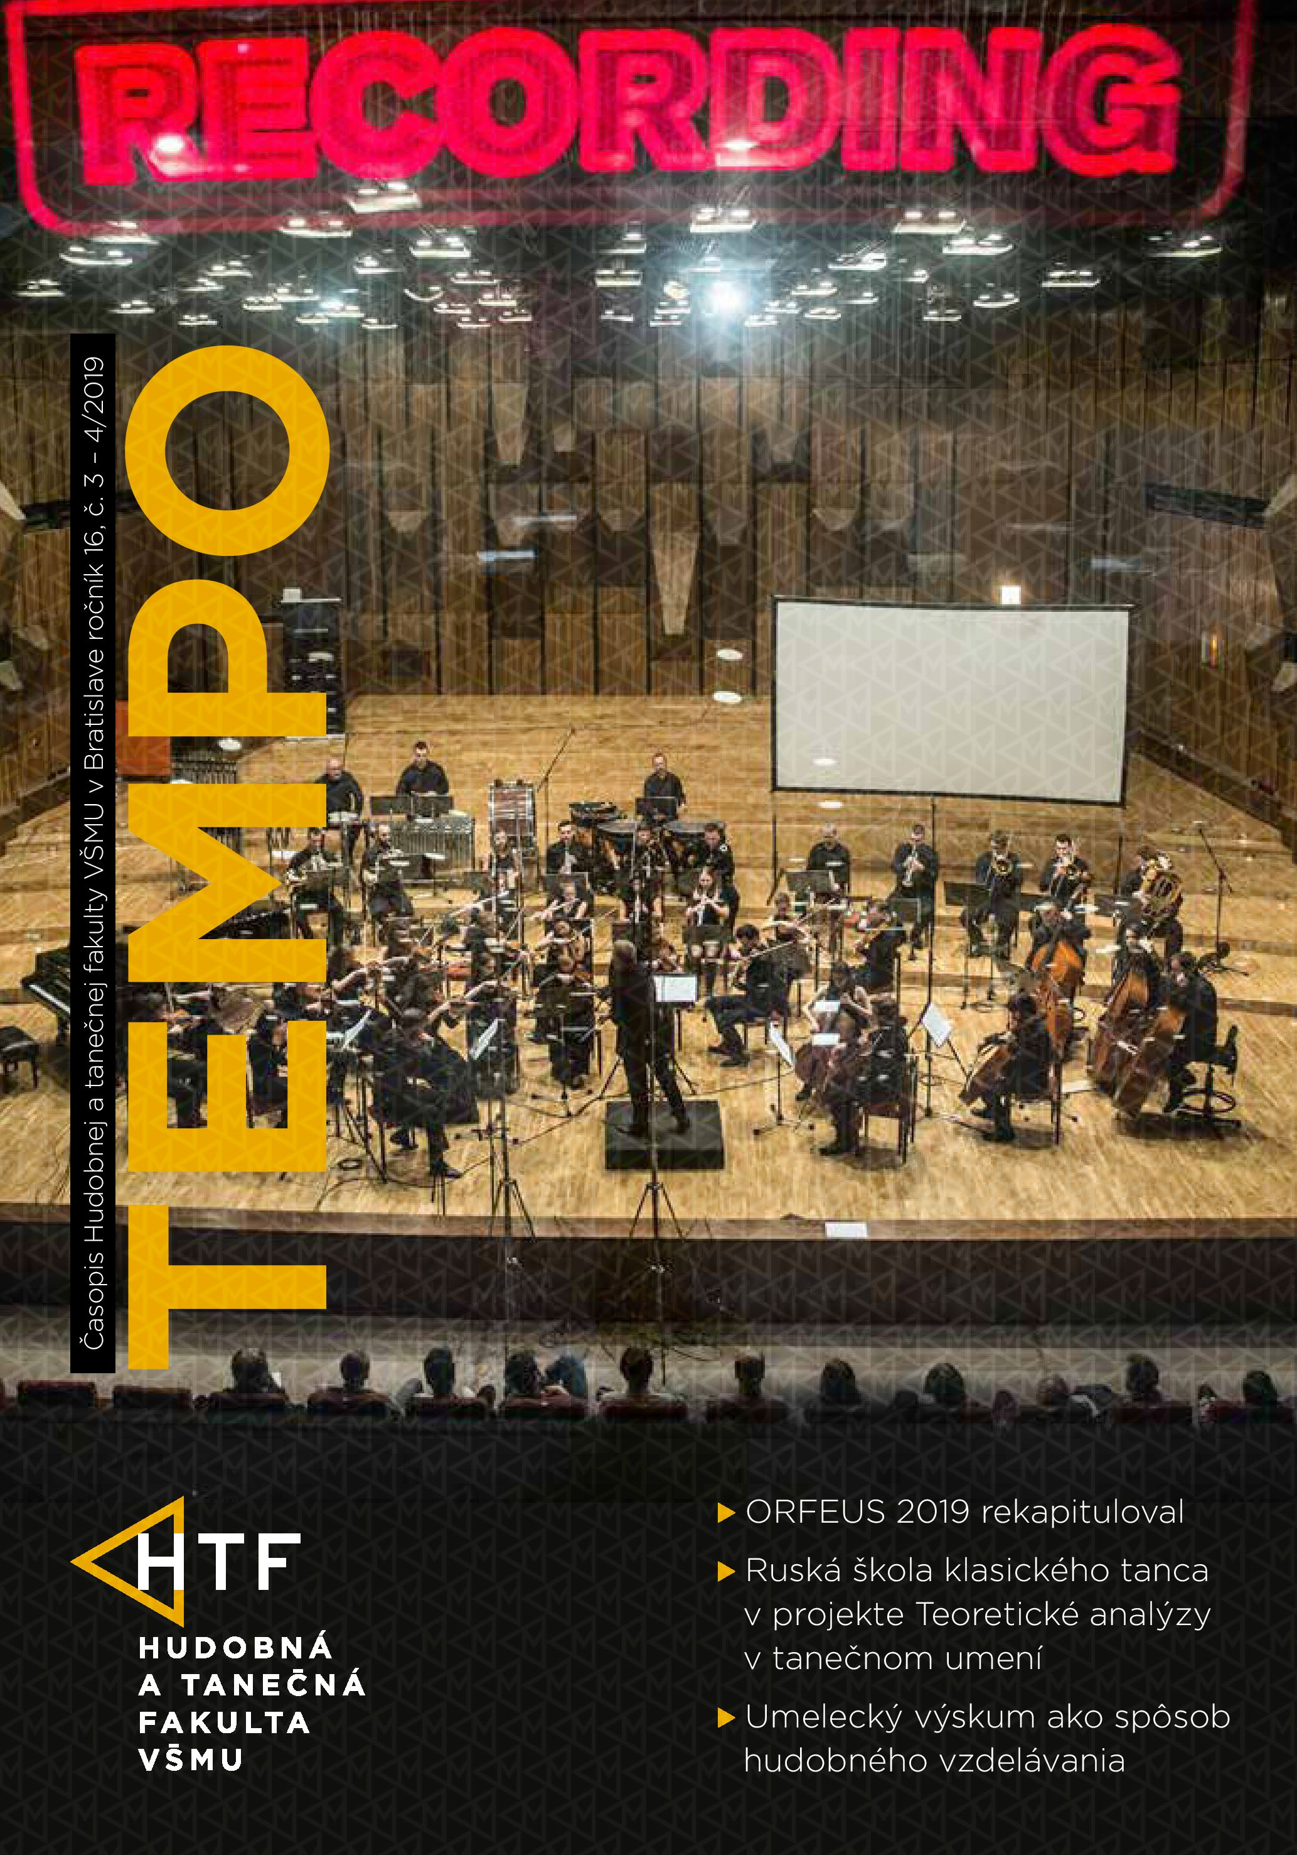
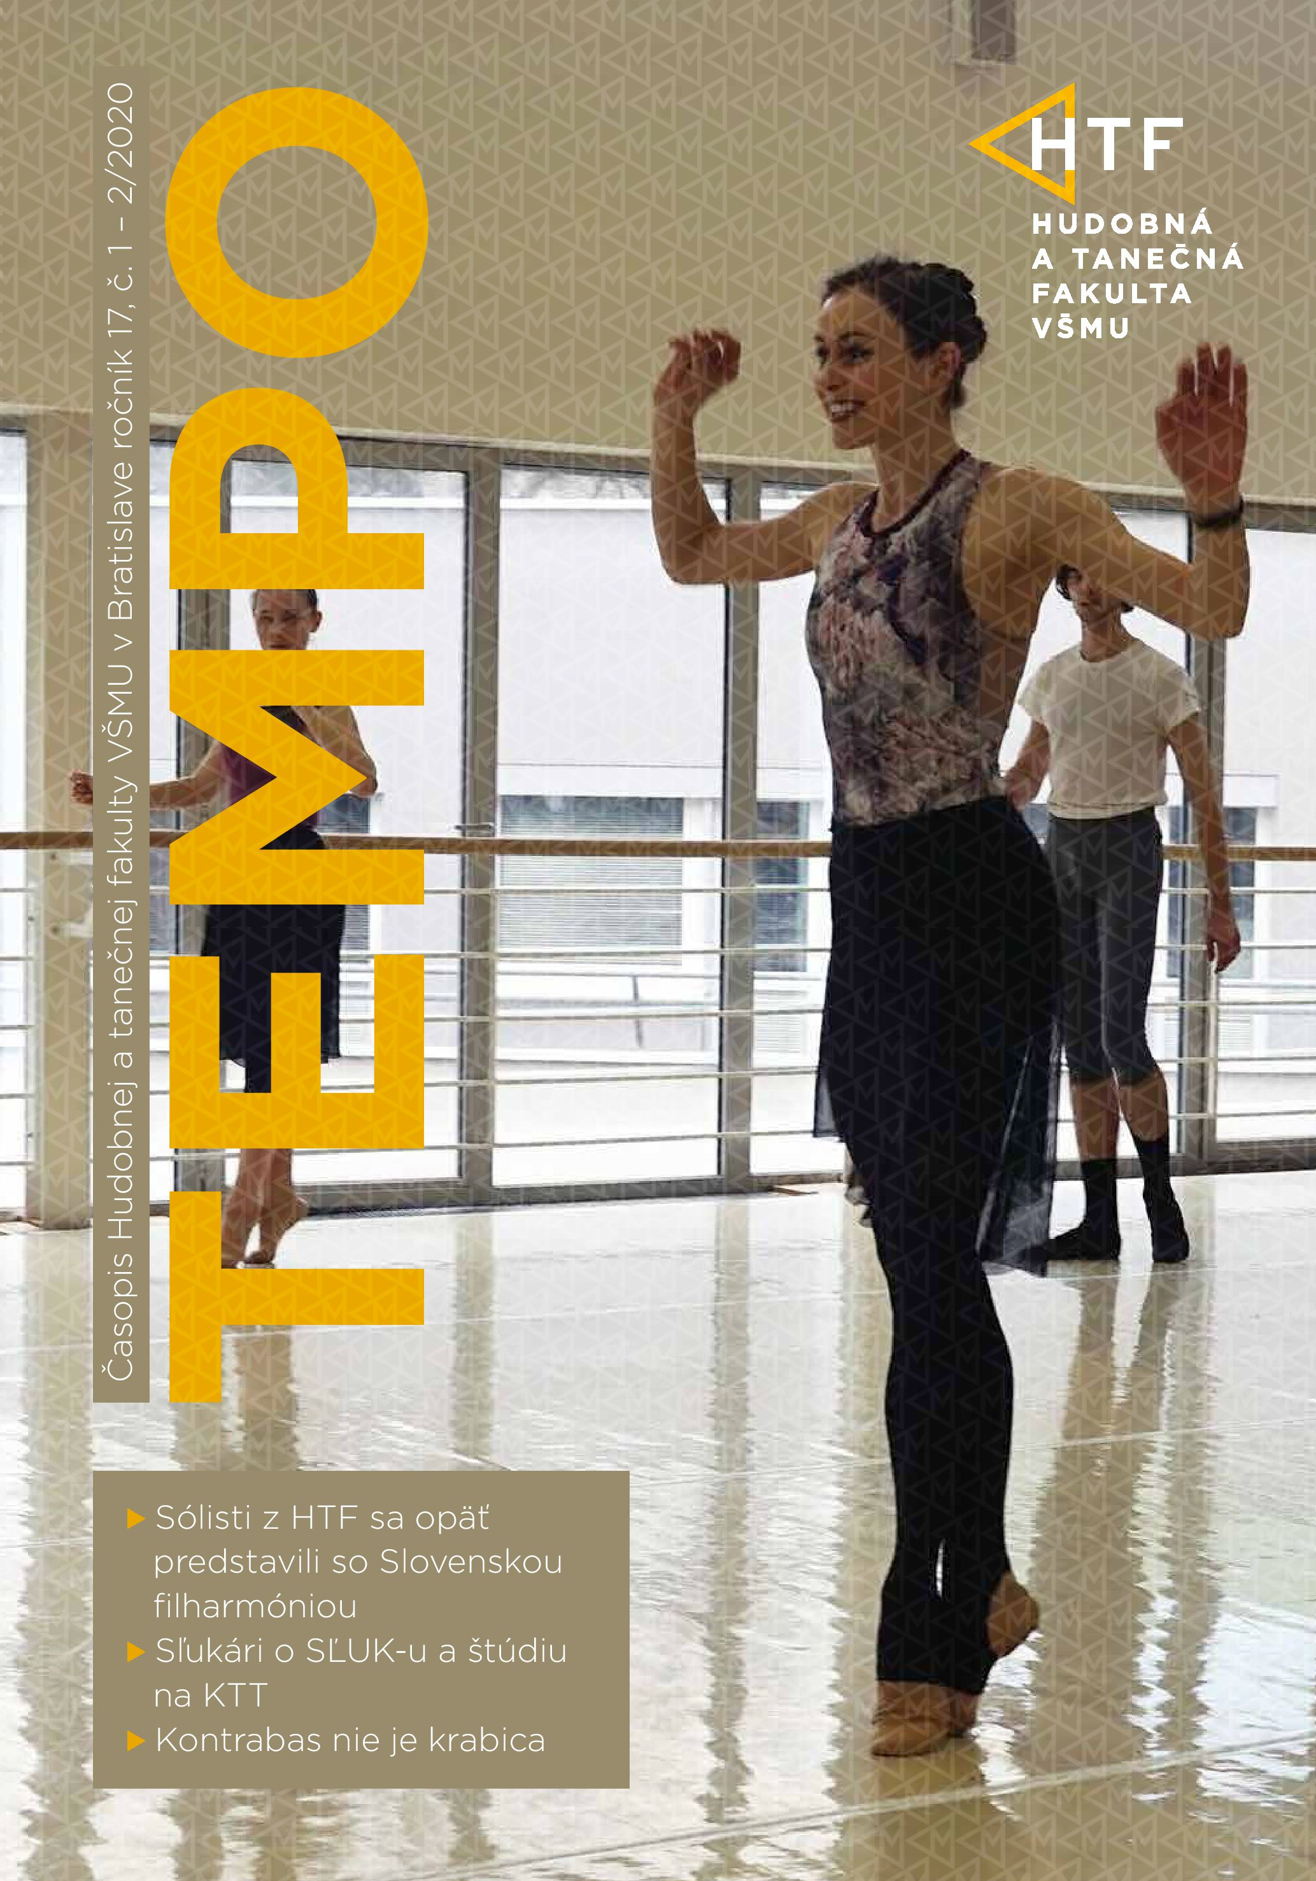
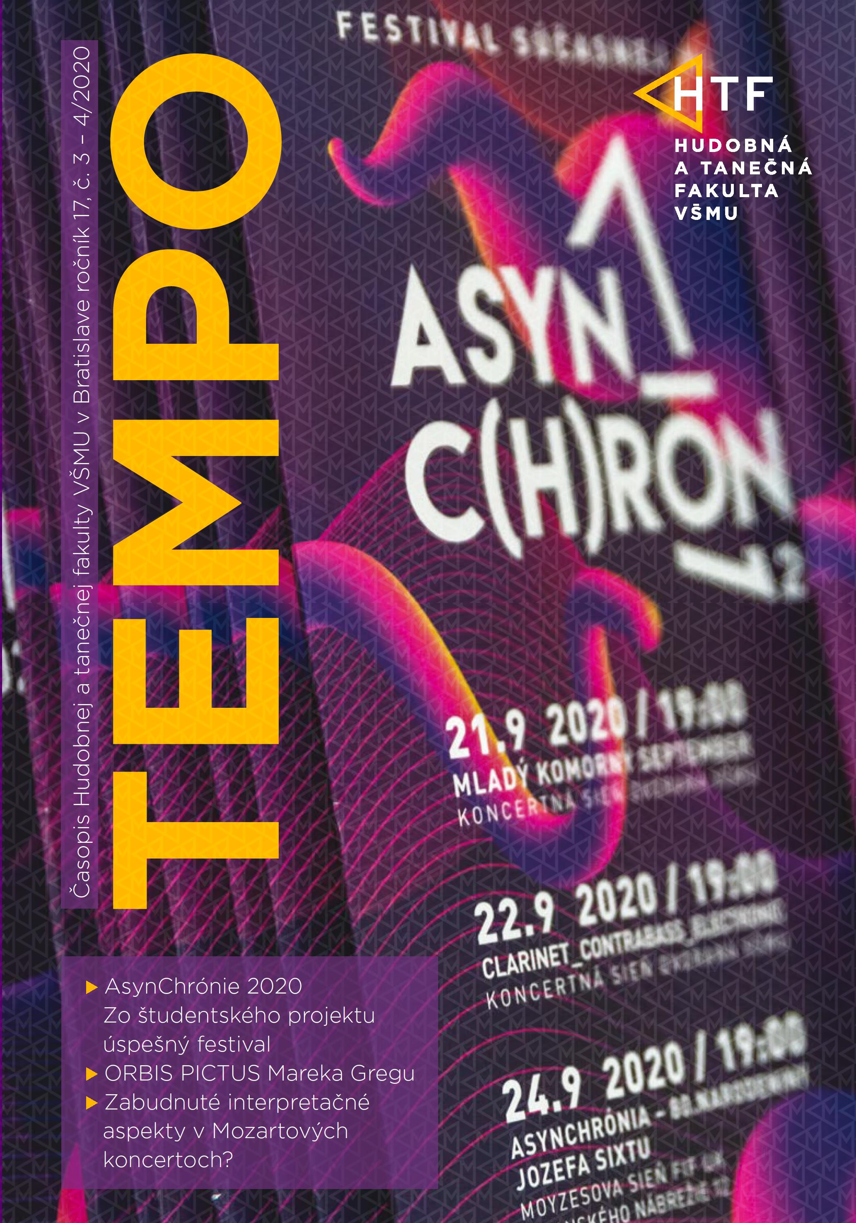
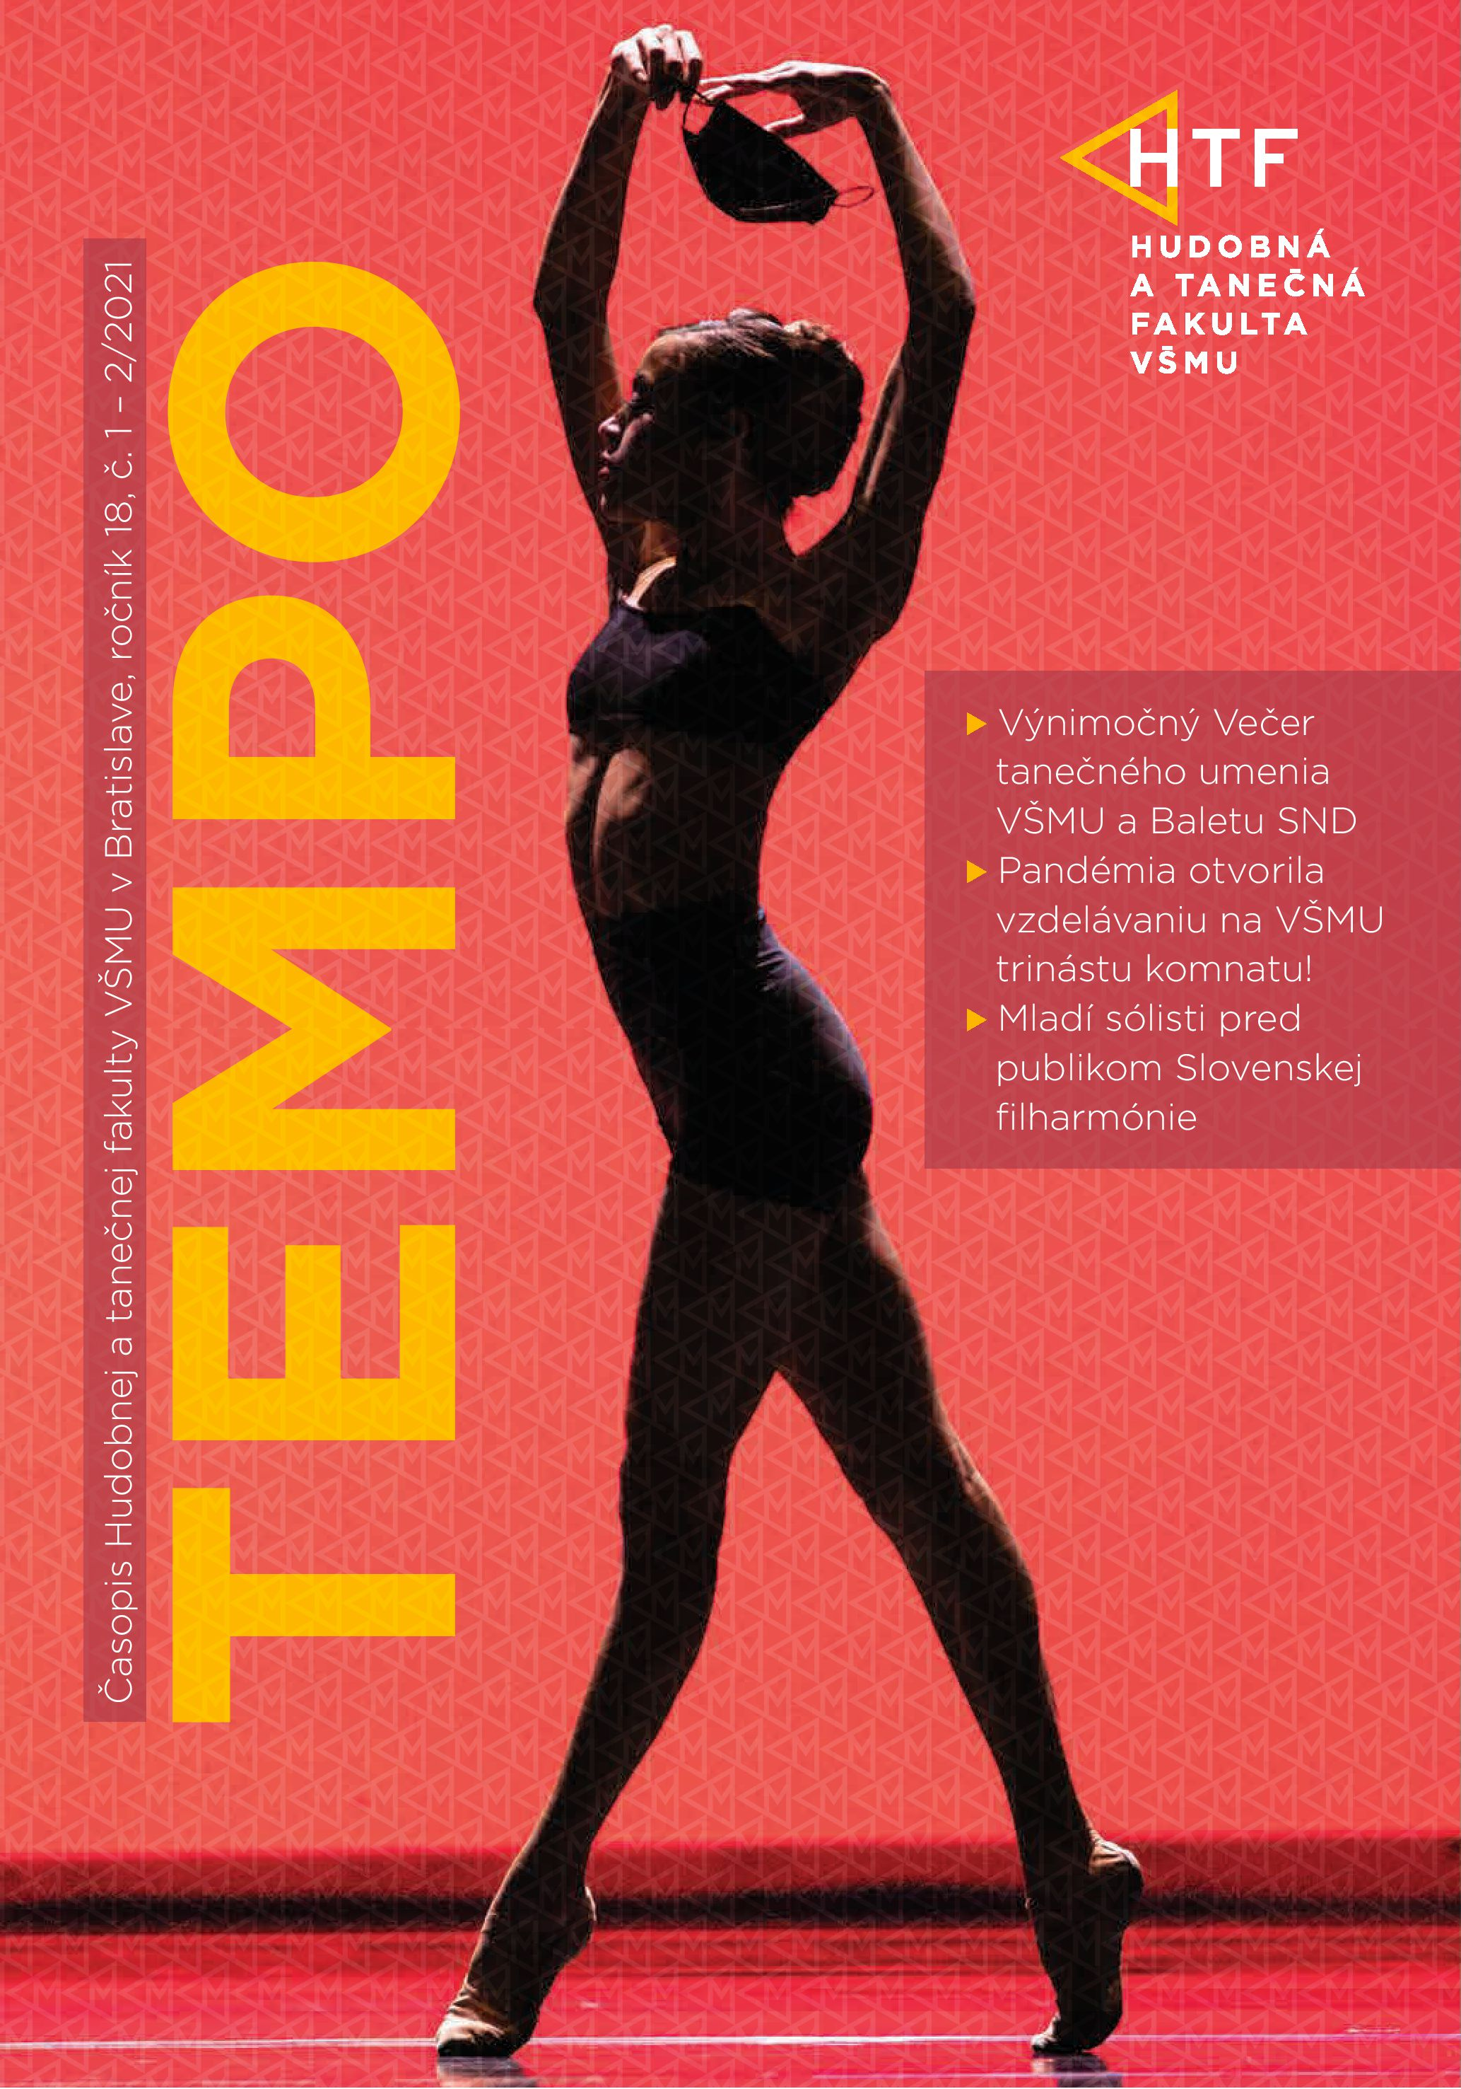
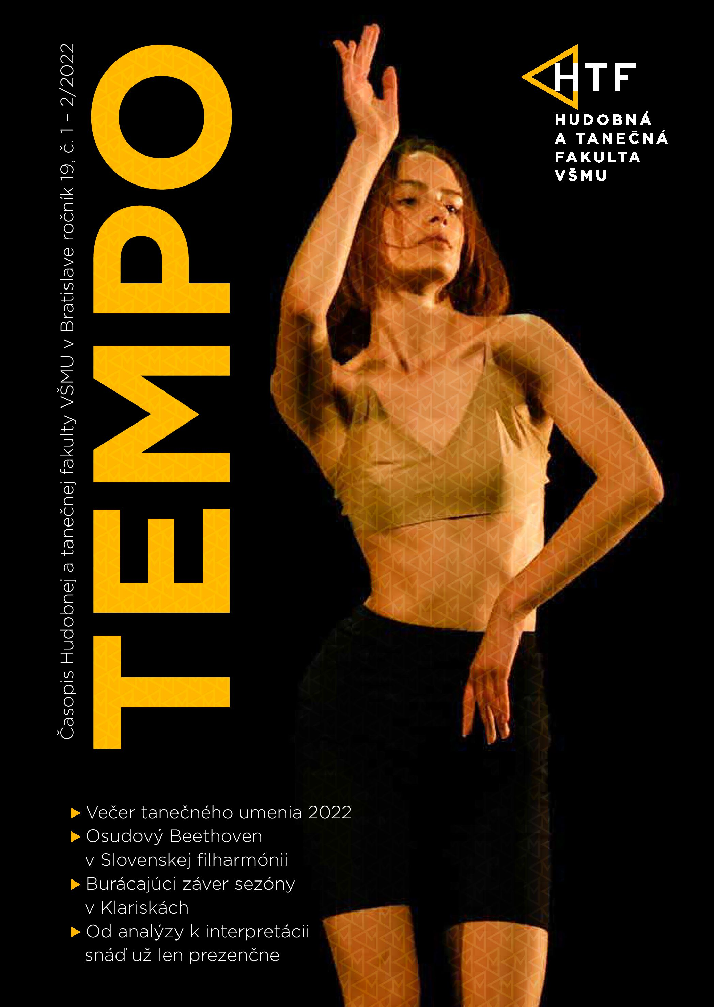
Outputs from workshops in the magazine TEMPO

Slide 7
Dance Research in 1. Project - Theoretical Analyses in Dance Art:
offered an opportunity for students, doctoral students, and teachers of Dance Department, through seminars and creative workshops, to get to know the principles and methods of evaluating artistic dance works from an artistic-scientific point of view,
invited pedagogues from universities abroad,
offered modern form of lectures from abroad,
linked information from the past with new development trends in dance styles,
linked social and economic influences for dance art.

Slide 8
Lecturers and universities:
Dr. Henriette Bannerman, PhD. London Contemporary Dance School
Susan Sentler Trinity Laban Conservatoire of Music and Dance, London
Virginie Mecéne Martha Graham School of Contemporary Dance, New York
MA Rachel Straus The Juilliard School New York
Brandon Collves Merce Cunningham Trust (2x)
Marína Krutovskaya School of Classical Dance, Moscow (7x)
Ryoko Kudo Limón Company, New York
Sharon Boots Vienna State Opera Ballet Academy, Vienna
Silas Farley New York City Ballet, New York (2x)
Simona Noja Vienna State Opera Ballet Academy, Vienna
Myra Woodruff Martha Graham School of Contemporary Dance, New York
Marina Meľnikova School of Classical Dance, Moscow (2x)
prof. Dorota Gremlicová, Ph.D. Academy of Performing Arts in Prague (AMU)

Slide 9
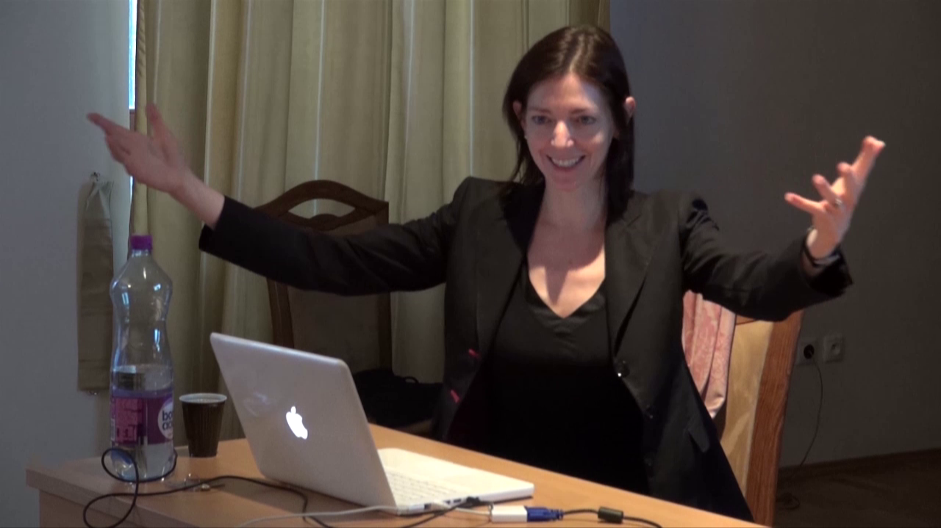
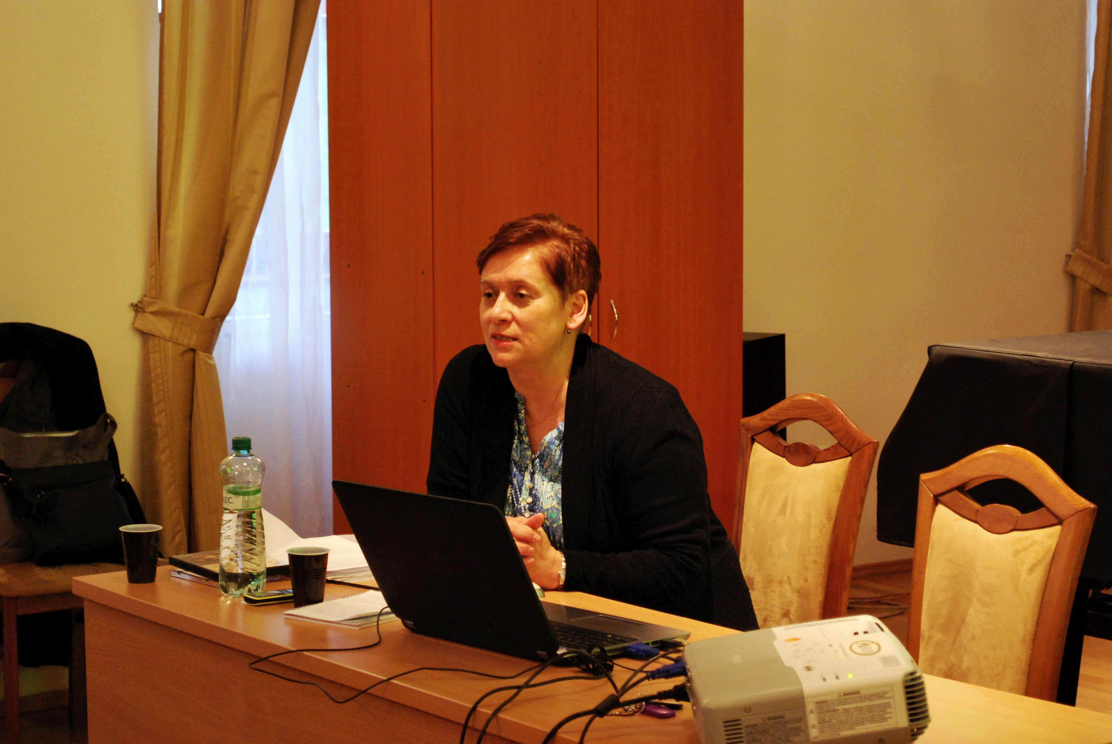
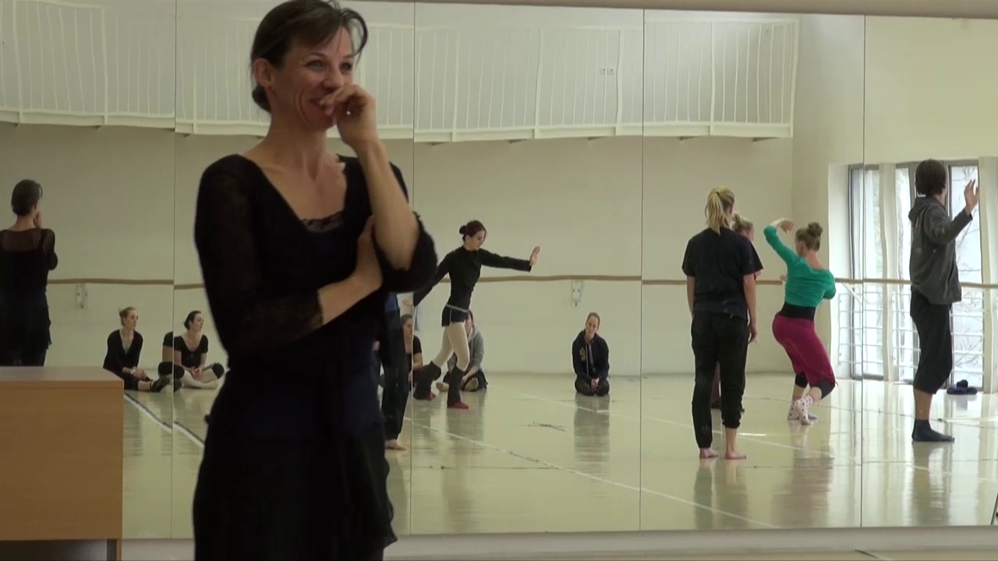
Theoretical Analysis in Dance Art

Slide 10
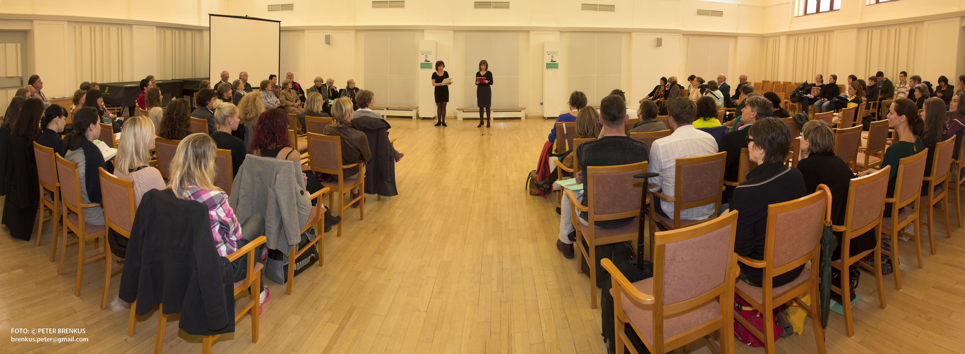
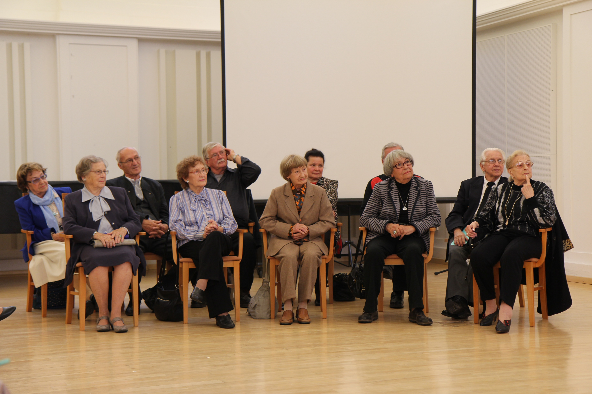
Dance Research in 2. Project - Dance congress – Tanec.SK (Dance.SK)

Slide 11
Dance congress – Dance.SK 2014 - 2024
The main topics of the congresses were:
2014 – Innovation and Creativity as a Strategy for Sustainable Development (34 contributions)
2015 – Personalities in the Art of Dance (35 contributions)
2016/2017 – Graduates of the Dance Department and Their Contribution to the Development of Dance Art in Slovakia (36 contributions)
2017 (autumn) – Traditions in Innovative Processes in Dance Art and Education (22 contributions)
2018 – Modern Dance in Slovakia before 1989 (25 contributions)
2019 – Dance Art – Connecting Education and Artistic Practice in Slovakia (23 contributions)
2021 – Development, Significance and Role of Dance in the Hundred-year-old History of Ballet Theater
in Slovakia (15 contributions)
2022 – Dance and Theory with Application to Artistic Practice (15 contributions)
2023 – The importance of movement analysis in the theory and practice of dance art (17 contributions)
2024 – A decade for the mapping and development of dance art (2014 - 2024) and visions for the future
in Research Center (will be held 14. and 15. of November 2024)

Slide 12
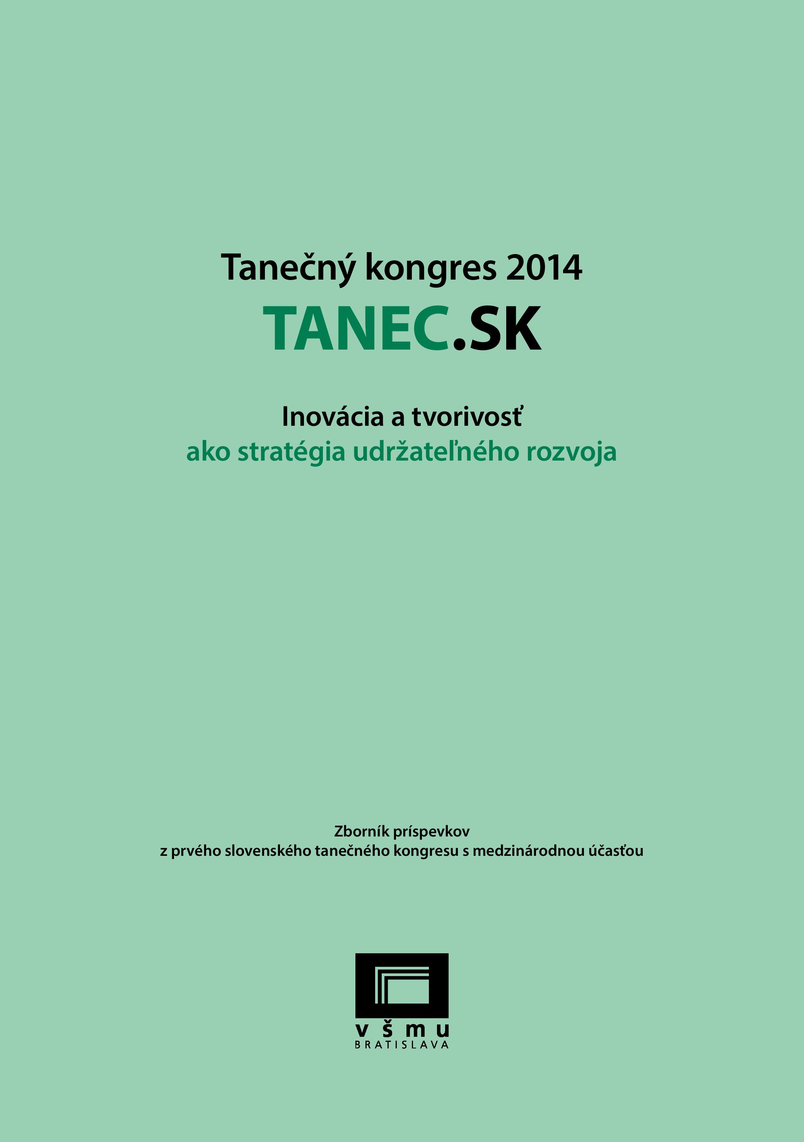
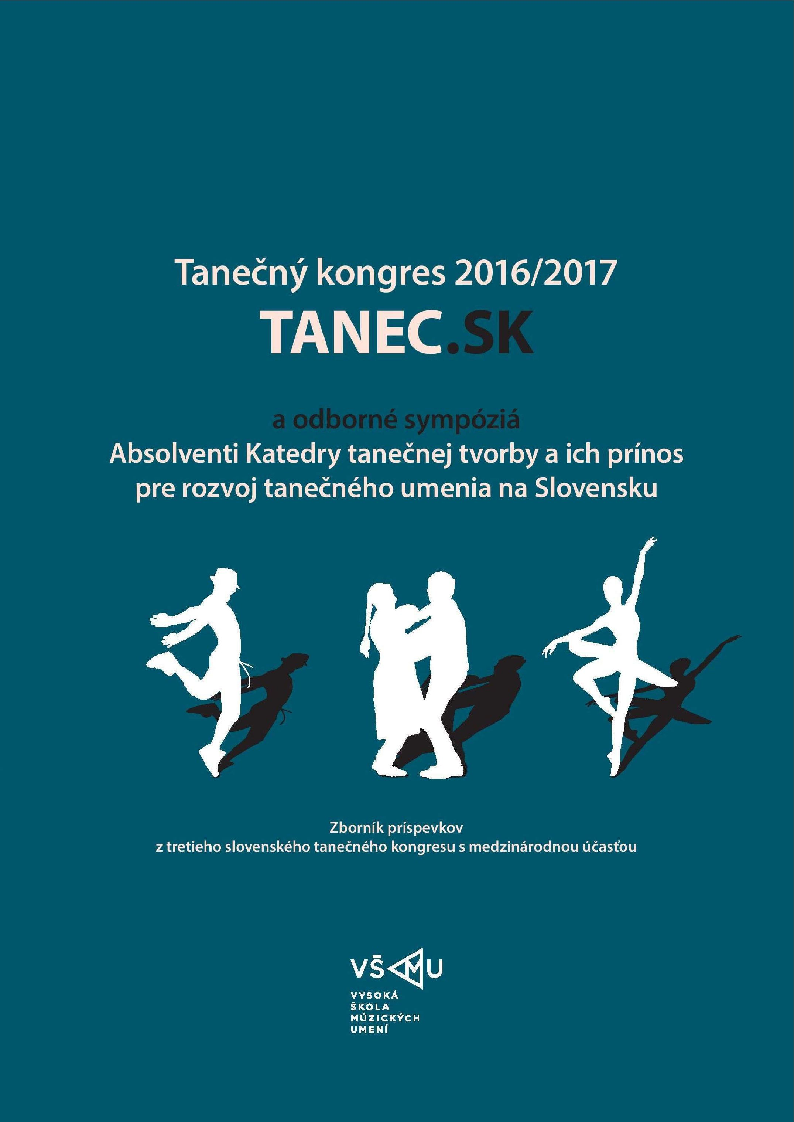
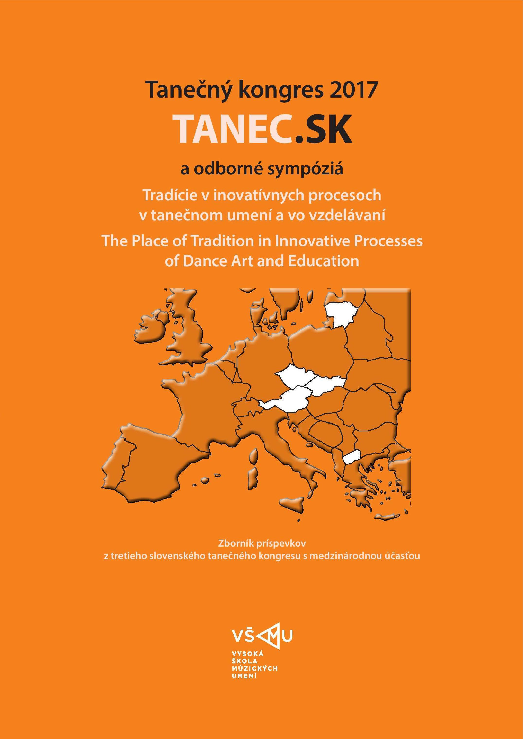
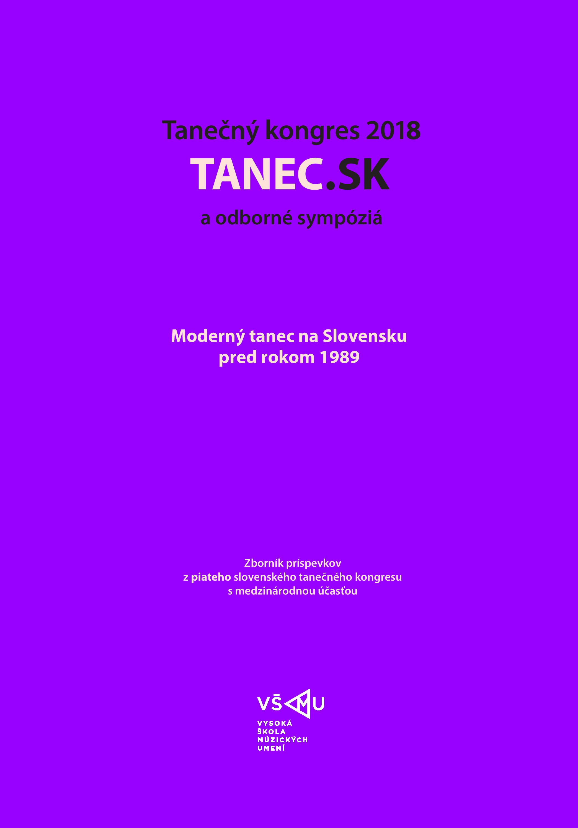
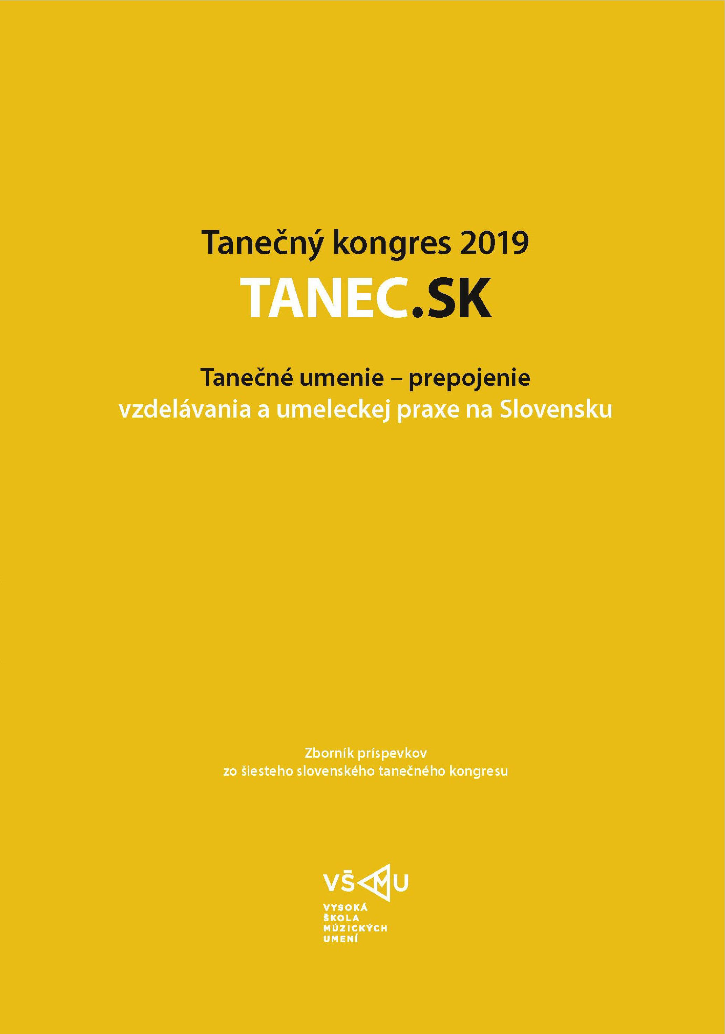
Proceedings
https://www.vsmu.sk/htf/katedry-a-pracoviska/centrum-vyskumu-htf/zborniky-tanec-sk/

Slide 13
3. Project - Presentation of Academic Dance Art Abroad (2016, 2018)
In 2016 and 2018, students and teachers were invited to:
Classical Dance School in Moscow,
Anton Bruckner Privatuniversität in Linz,
Magyar Táncmuvészeti Fóiskola in Budapest,
Vienna State Opera Ballet Academy,
Skopje Dance Academy ESRA, University of Skopje,
Music and Arts University of the City of Vienna.

Slide 14
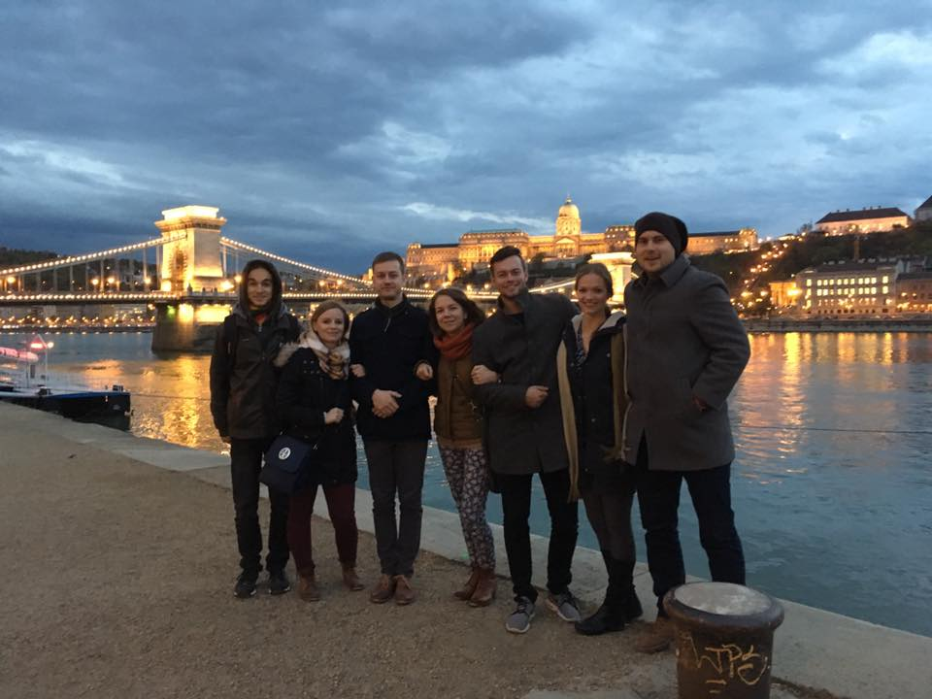
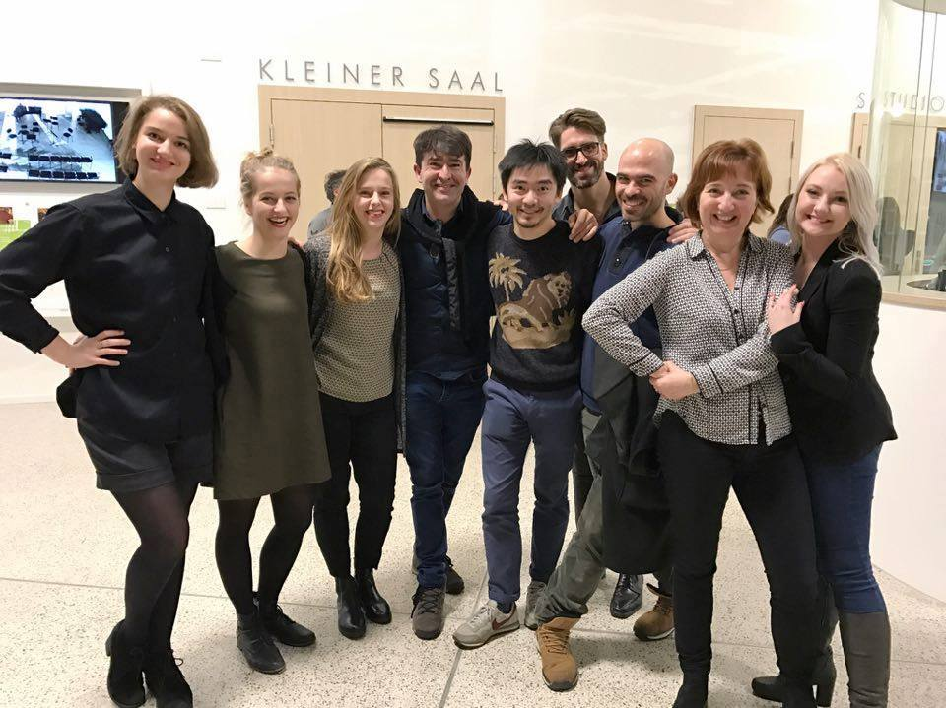
Presentation of Academic Dance Art Abroad (2016, 2018)

Slide 15
4. Project -Festival of Dance Universities SHARE 2017, 2019, 2022 and 2024 coordinated by Miroslava Kovářová
2024 participants:
Dance Department of The Academy of Performing Arts, Bratislava (Slovakia)
Dance Department of University of Goce Delchev, Skopje (North Macedonia)
Anton Bruckner Privatuniversität, Linz (Austria)
Music and Arts University of the City of Vienna (Austria)
Lithuanian Academy of Music and Theatre/Dance and Movement Department, Vilnius (Lithuania)
Dance Department, Academy of Performing Arts in Prague (Czech Republic)
Duncan Center Conservatory, Prague (Czech Republic)
Budapest Circus Arts and Contemporary Dance College (Hungary)

Slide 16
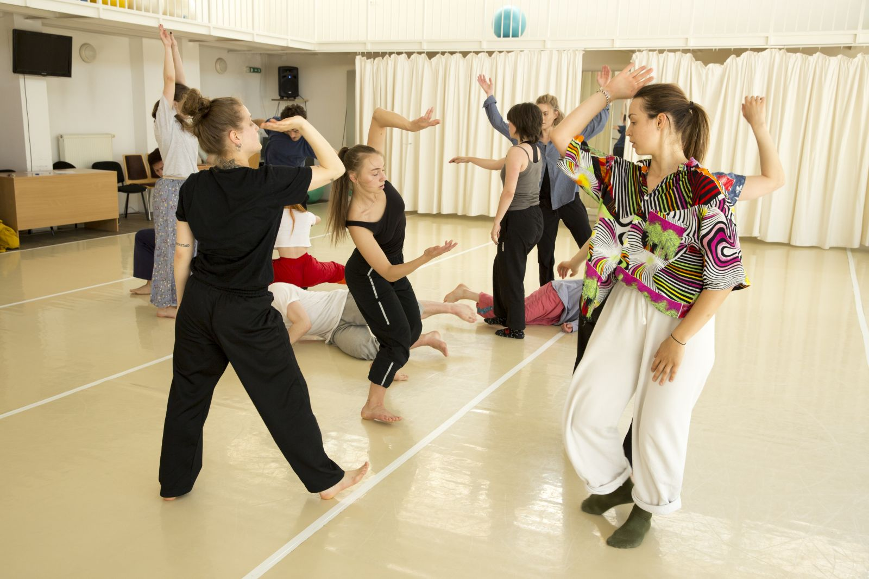
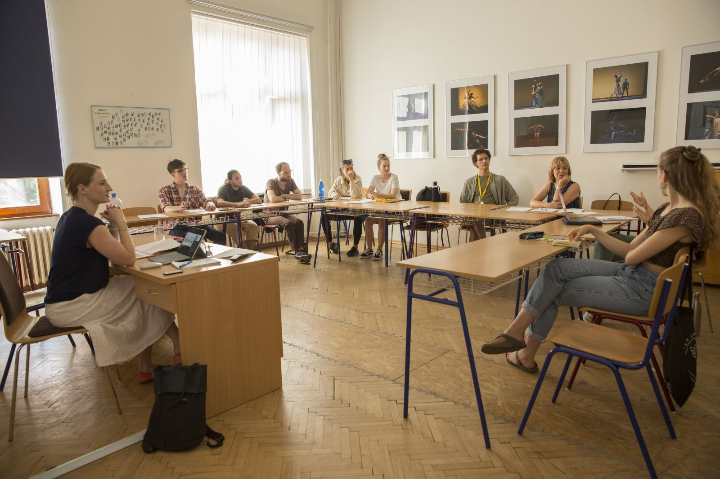
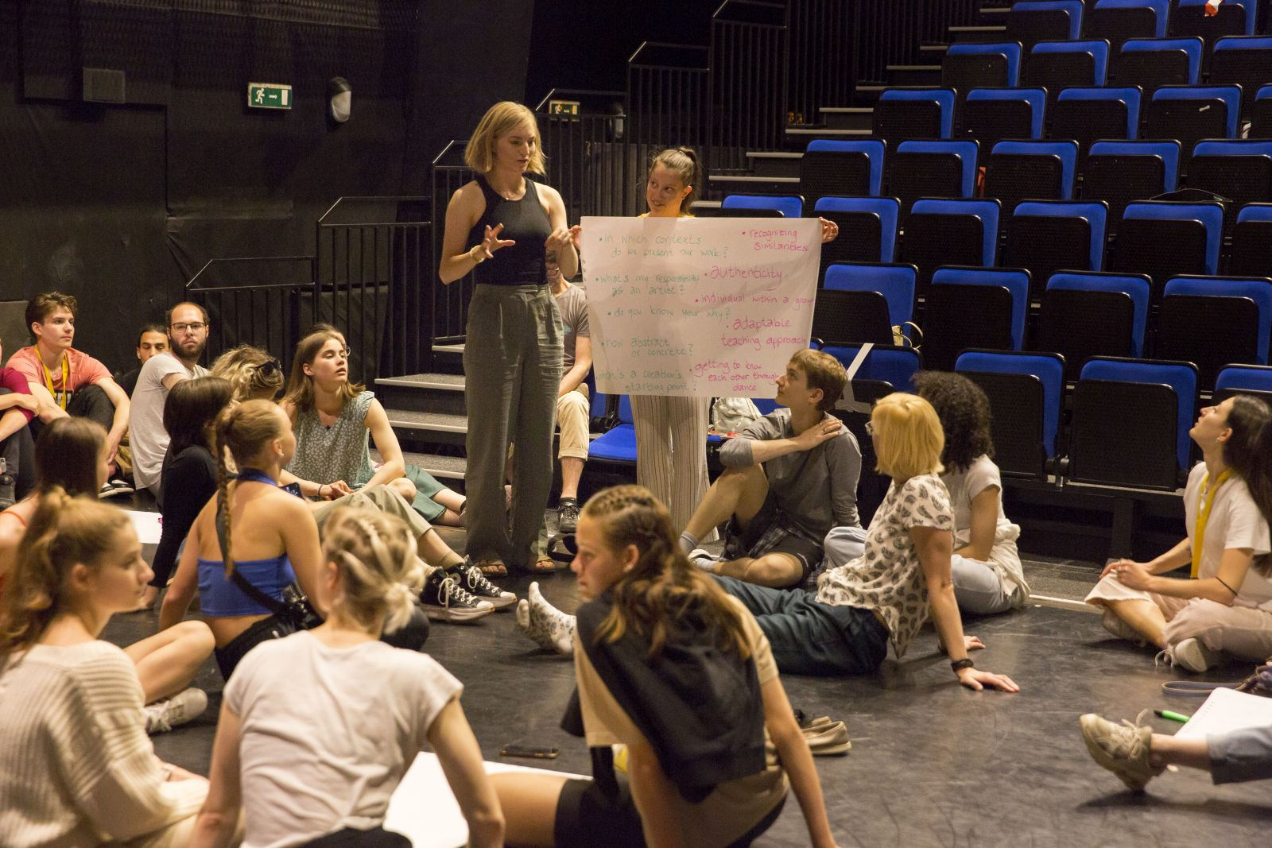
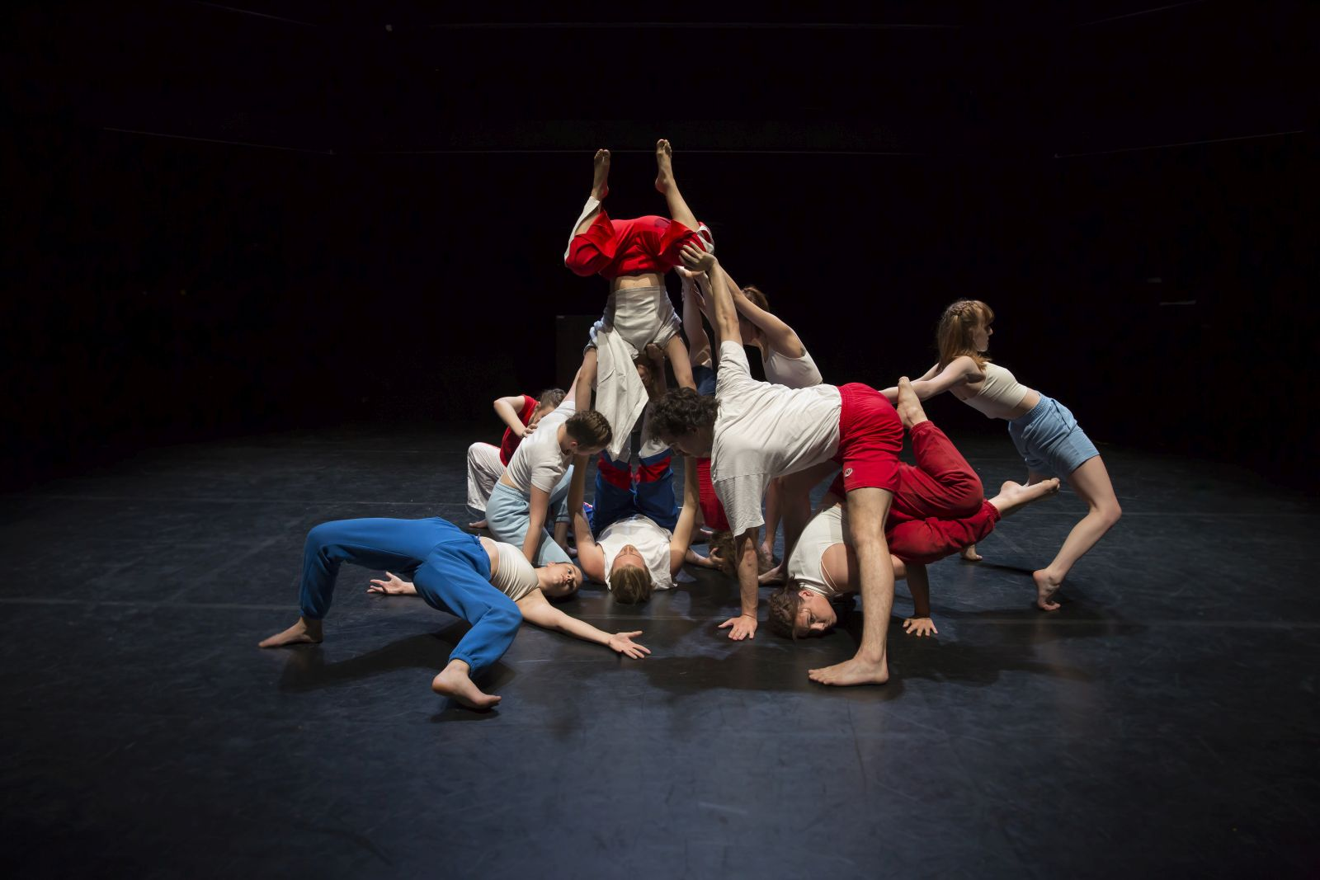
Festival of Dance Universities SHARE 2017, 2019, 2022 and 2024 coordinated by Miroslava Kovářová

Slide 17
5. Project - Culture and Education Funding Agency of Ministry of Education, Science, Research and Sport of the Slovak Republic (KEGA):
Ivica Liszkayová 2017 – 2019
Dance.SK (congresses, symposia, artistic performances Evening of Dance Art of Dance Department and Ballet of Slovak National Theatre)
Marta Poláková 2018 – 2020
Development of choreographic thinking in the process of dance education
Miroslava Kovářová 2020 – 2022
Dance science – contemporary theoretical and methodological approaches to dance research
Kristián Kohút 2023 – 2025
Slovak Choreographers and its works

Slide 18
Possibilities of financial support that could be used for The Research Center in the years 2011 – 2024:
2011 – 2015 – The Ministry of Culture
of the Slovak Republic
2016 – 2024 – The Fund for Art Support
2017 – 2024 – The Ministry of Education, Science, Research and Sports
of Slovak Republic

Slide 19
Possibilities of financial support individual research and travel mobilities abroad for congresses
2016 – 2024 – The Fund for Art Support
2017 – 2024 – The Ministry of Education, Science, Research and Sports of Slovak Republic

Slide 20
Individual research on the context of the genesis of modern dance in Slovakia from the period 1970-1990
2017 - The beginnings of modern dance in Slovakia since 1971- non-professional activity Bratislava dance ensembles:
EŠMFT, Alfa, Bralen Reflex, Allegro/Prens
2018 - Since 1971- non-professional activity dance groups
outside the capital city
2023 - The context of the genesis of modern dance in Slovakia from the period 1970-1990 from the point of view of the political structure of the state
2023 - The most important figures for the development
of modern dance and their artistic and research activities
2024 - Support for participation in the 61st World Congress in Athens
and to present research in the institution as well as individually

Slide 21
Thank you for your attention.
Supported using public funding
by Slovak Arts Council

