Slide 1
Dance Studios, reaching goals through smart strategies of knowledge and collaboration
MEXICO
Danza y Arte Studio Nayeli Quintanar
International Dance
Pachuca Hidalgo

Slide 3
HOW IMPORTANT IT IS TO CREATE CONNECTION WITH OTHER INSTITUTIONS
TO REACH OBJECTIVES

Slide 4
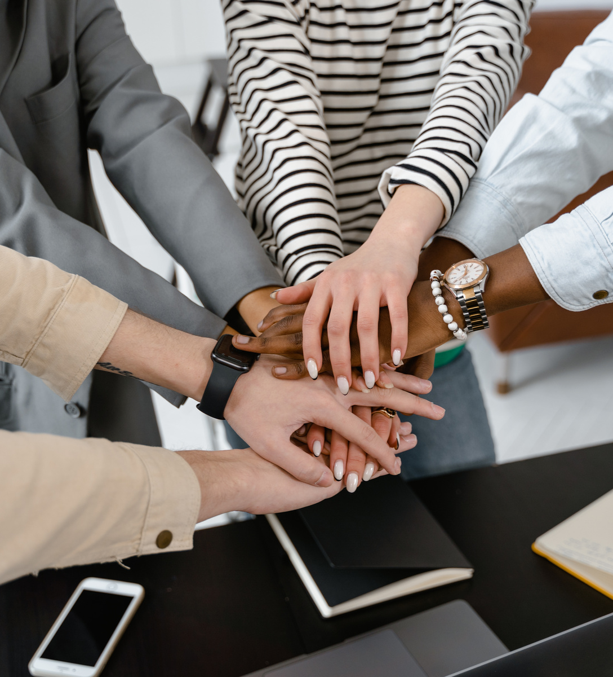
WORK THROUGH COLLABORATION
STATE
State government/groups/independent dancers/dance studios/universities/researchers
NATIONAL
Dance studios nexwork/research network/ethics network/ against violence network/links all over Mexico
INTERNATIONAL
International standards and collaboration/ certification/ exchange of ideas/ mutual understanding/research

Slide 5
CND MEXICO
The cultural manager from Michoacán Mexico Erandi Fajardo Robledo is the president of CND. She leads the conseil and through different efforts and making connection with other managers, researchers and dancers all over Mexico, she recognizes the collaboration and impulsers to promote better work conditions for dancers.
This year 2024, tha national campaign is called TRABAJO DIGNO PARA DANZA
“DIGNIFIED WORK FOR DANCERS”

Slide 6
LINK HIDALGO
COMITÉ ESTATAL DE LA DANZA EN HIDALGO
Collaboration with three more people dedicated to dance.
We are managers in our state and we are working hard in order to reach more objectives and benefits for our colleagues.
There is a network and more people dedicated to dance are joining our groups to add more ideas and express their needs.

Slide 7
AN EXAMPLE OF WHAT WE HAVE REACHED THROUGH COLLABORATION
State management - National management
More events for organizers, researchers, dance studios and companies to show their projects at different sites.
Better prices for renting theaters
Example:
Cost of Gota de Plata theater: $ 5,000 dollars
New cost: $1065 dollars
In collaboration with OPERADORA DE EVENTOS , government administration in Hidalgo State.

Slide 8
OTHER ACTIONS FOR INCREASING JOBS
Designing of public policies based on a diagnostic based on real data.
Increasing budget for dance.
Cultural national representatives having more communication with other representatives, linking culture with the national and state departments of Economy, tourism, health, well-being.
Offering more sites for performers, organizers, researchers to reach more people interested in dancing.
Reducing rent prices of different places to promote culture all over Mexico.
Having more opportunities to have access to public health insurance.

Slide 9
Presentación de empresa
nayquintanar77@gmail.com
@quintanarnayeli
THANKS

