Slide 1
The meaning Of Harem
Essay
By Rosanna Hürrem

Slide 2
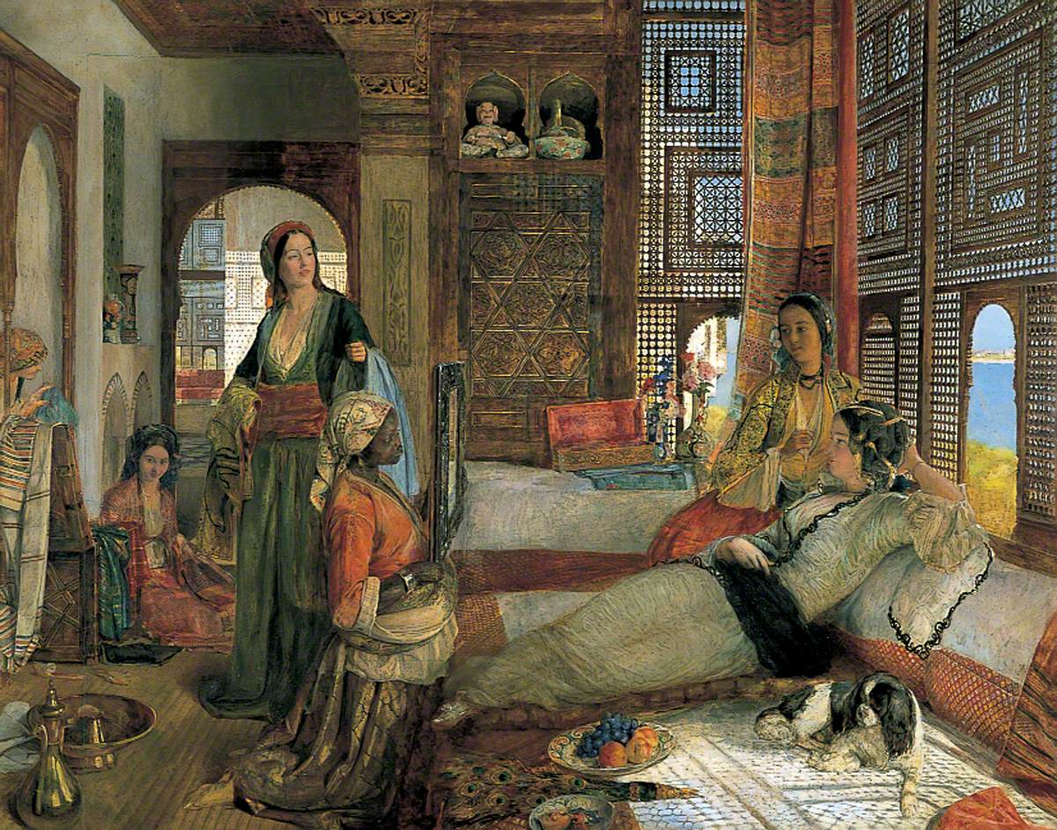
The Women Sultanat - Kadinlar Saltanati
The women of the imperial harem - particularly the mother of the reigning sultan, known as Valide Sultan also played an important political role "behind the scenes", effectively ruling the Empire during the period known as the Sultanate of Women.
“The Harem” by John Frederick Lewis (1804–1876)
Birmingham Museums Trust

Slide 3
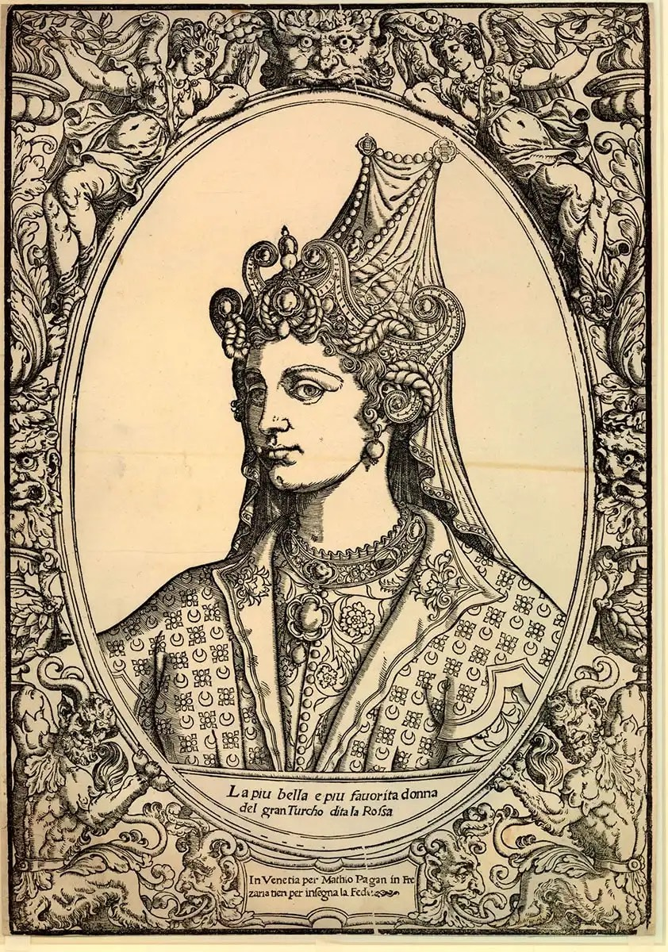
Hürrem Sultan "the joyful" or “the one who brings joy"
Her real name was Aleksandra Anastasija Lisowska also known in Europe as Roxelana. Born in Rohatyn 1504 but the date of birth of Hürrem Sultan is however controversial, some sources state that she was born in 1502. She died in Constantinople on 15 April 1558. The name Hurrem was given to her by Sulejman I himself when Roxelana decided to accept the Islamic religion. Regarding her origins, there are not many sources other than literary ones of handed down stories. What is certain and documented by the court archives was that she was the favorite concubine. and then legal wife of the Ottoman sultan Suleiman I (Suleyman the Magnificent) and mother of his successor Selim II.
Portrait bust in profile of Roxelana, the favorite wife of Suleyman the Magnificent, Matteo Pagani, 1540s, via the British Museum

Slide 4
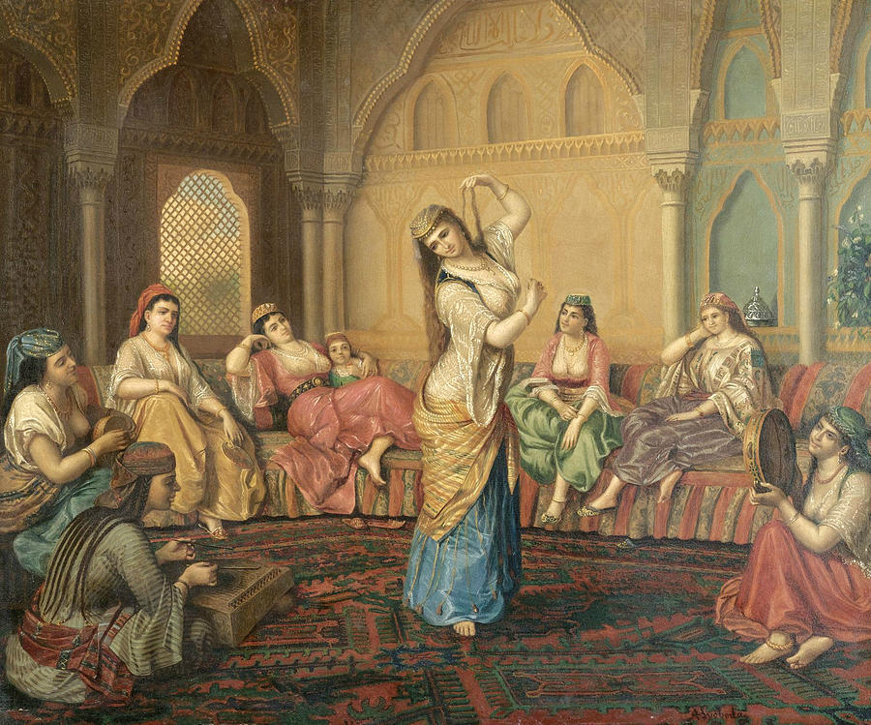
Dance and Harem
Above all, dance was appreciated. The more expert slave-dancers enjoyed greater freedom, they could even go to study in the homes of the most famous masters, accompanied by two elderly women and were allowed to compete with musicians and poets in the great parties organized in the palaces which even lasted all night. The dance troupe was made up of ten dancers plus a head dancer and an apprentice. In particular they performed the kocek dance (which in the rest of the country was instead performed by young men dressed as women), characterized by brass rattles on the fingers, or castanets; or the tavsan oyunu (rabbit dance).
For each type of dance the dancers wore traditional costumes, characteristic of each one.
The musical accompaniment was performed with musical instruments such as the lute ('ud), the violin, the tambourine (duff), the castanets (çalpâre), the flute (ney), and a kind of lute called tambur. When, with the end of the Ottoman Empire in 1909, the harem was dissolved, women left their gilded cage. Some managed to return to their family, others used the arts learned in the harem to earn a living.
The Harem Dancer by Sandor Alexander Svoboda

Slide 5
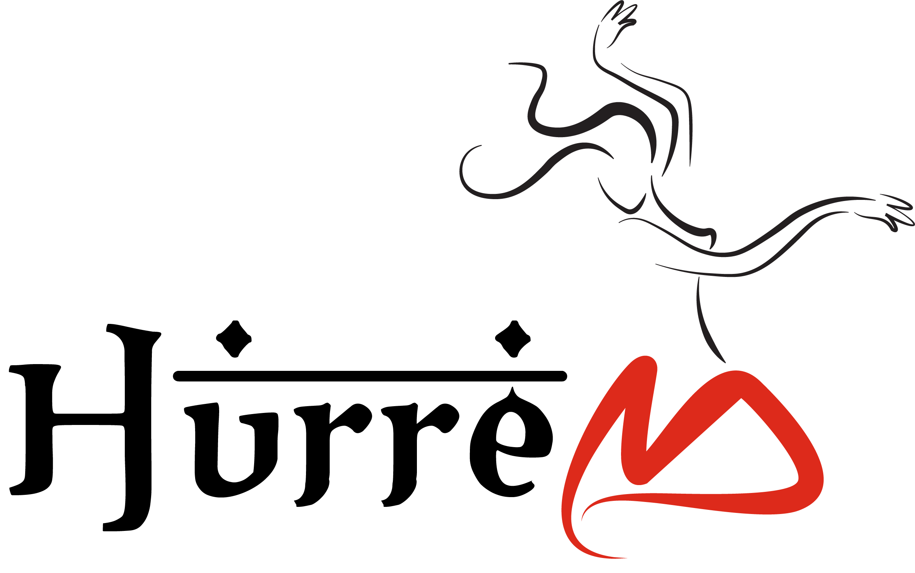
Thanks
I thank the CID for the opportunity to present my essay during this important congress in Athens.

