Slide 1
HOW WE LEARN, HOW WE TEACH MOTOR SKILLS ACQUISIATION
ZEYNEP SILE

Slide 2
According to Scmidt and Wrisberg, motor learning is defined as: “The changes associated with practice or experience, in internal processes that determine a person’s capability for producing a motor skill” (2008).

Slide 3
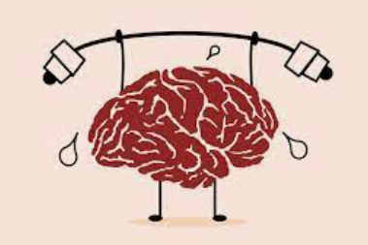
The connection between the brain and the body involves our brain sending signals to our muscles through nerves, ensuring they contract and operate as needed, for as long as needed, and then transferring this to long-term memory. It is considered that a student has learned when they can consistently repeat the same skill.

Slide 4
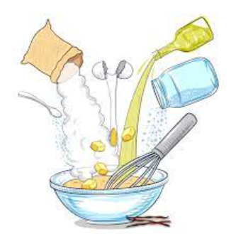
Perception: Attention and observation of a demonstrated skill
This first part necessities a motor plan which can be described as a plan for converting a series of instructions in our brain into action.

Slide 5
A student new to ballet will go through different processes compared to an experienced student, and an adult student will differ from a young child.

Slide 6
Demonstration: The movement must be performed correctly as the student will use this first input as a reference to attempt to replicate the image.
Mental Activity: The student evaluates the movement they have seen and received instructions for and plans an action.

Slide 7
Replication of what has been observed: Trial Phase
Gathering Clues
Creating a Mental Image
Planning for Motor Skills
Displaying the Skill

Slide 8
Feedback

Slide 9
Repetition
Once appropriate neurological pattern set up, repetition will ingrain the skill into the body.
Correction Phase
Monitoring Performance Internally and Externally
Evaluation and Replanning
Retrial
Perfection Phase
Practicing with Ongoing Monitoring
Reviewing Performance

Slide 10
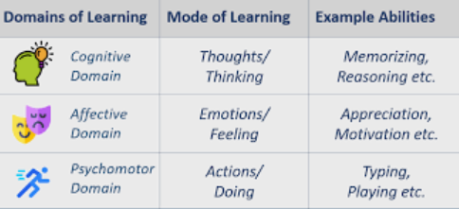
Bloom's taxonomy

Slide 11
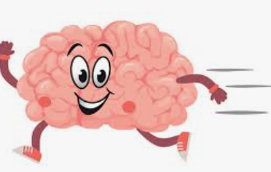
Creating meaning
The clusters of meanings and stories that we create in our minds decide whether we will act, how much we will do, or what we can do.
When a meaning formation aimed at a goal and a significant value contribution are established, internal motivation is also achieved.

Slide 12
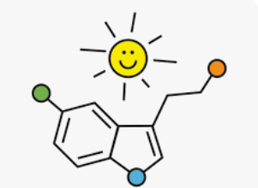
Dopamine and Motor Skills
The Effect of Dopamine on Attention and Focus
How Dopamine Influences Perception
Dopamine, Stress, and Excitement
The Impact of Dopamine on Mood
How Does Dopamine Affect Motivation?
Dopamine and Creativity

Slide 13
Thank you for listening

